Slide 1
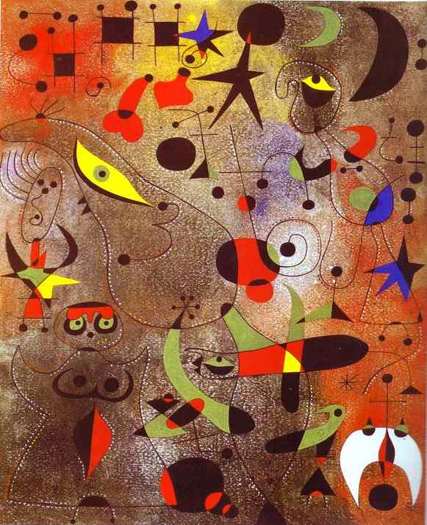
THE PRINCIPLES OF ART
BALANCE
EMPHASIS
MOVEMENT
PATTERN
PROPORTION
RHYTHM
UNITY
VARIETY

Slide 2
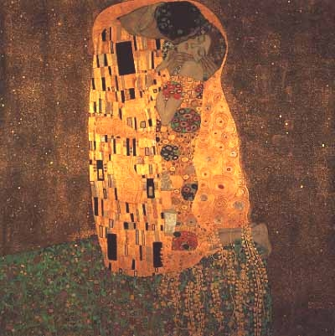
Gustav Klimt
Pattern
Pattern means the repetition of an element (or elements) in a work.
An artist achieves a pattern through the use of colors), lines, or shapes .

Slide 3
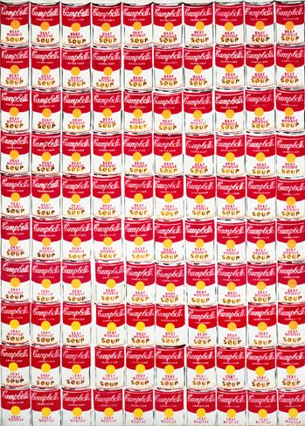
Andy Warhol

Slide 4
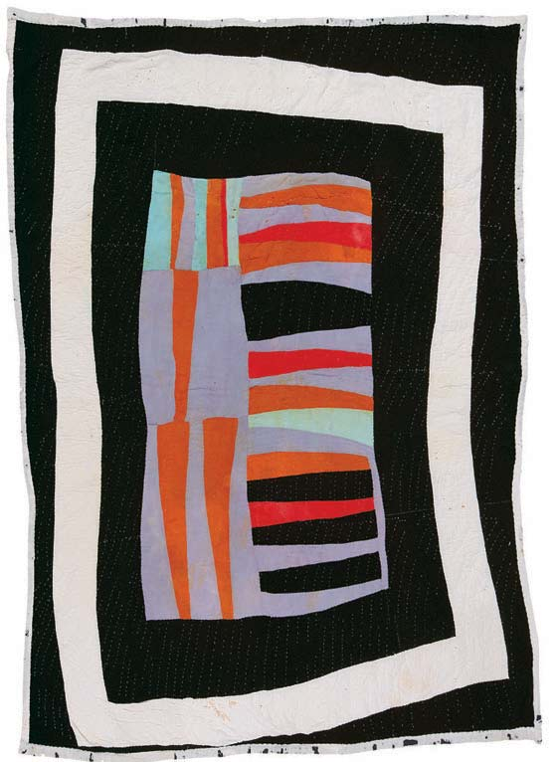
Gee’s Bend Quilts

Slide 5
Ancient Greek Geometric Period Vase

Slide 6
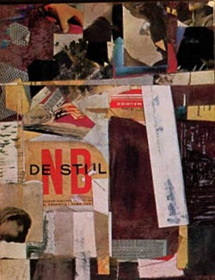
Kurt Schwitters
Variety
Variety occurs when an artist creates something that looks different from the rest of the artwork. An artist may use variety to make you look at a certain part or make the artwork more interesting.

Slide 7
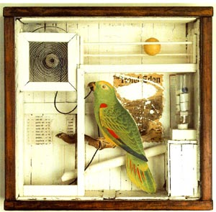
Joseph Cornell

Slide 8
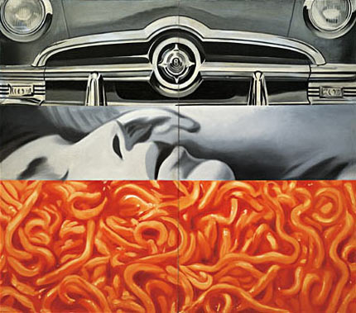
James Rosenquist

Slide 9
Robert Rauschenberg

Slide 10
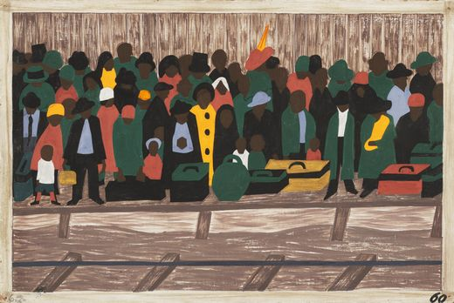
Jacob Lawrence
Unity
Unity is the feeling that everything in the work of art works together and looks like it fits.

Slide 11
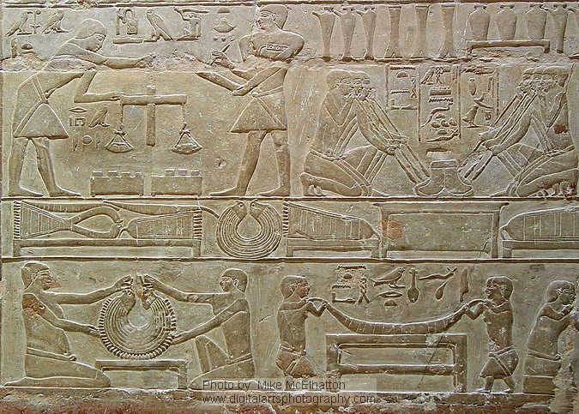
Egyptian Hieroglyphics

Slide 12
Paul Klee

Slide 13
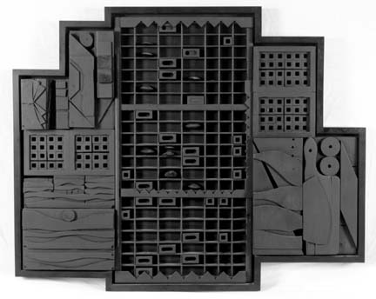
Louise Nevelson

Slide 14
Georgia O’Keeffe
Balance
Formal Balance usually is achieved by the artist placing objects in the work in a symmetrical or equal-sided arrangement. Informal Balance is created when an asymmetrical layout is used. Radial Balance occurs within a circle design.

Slide 15
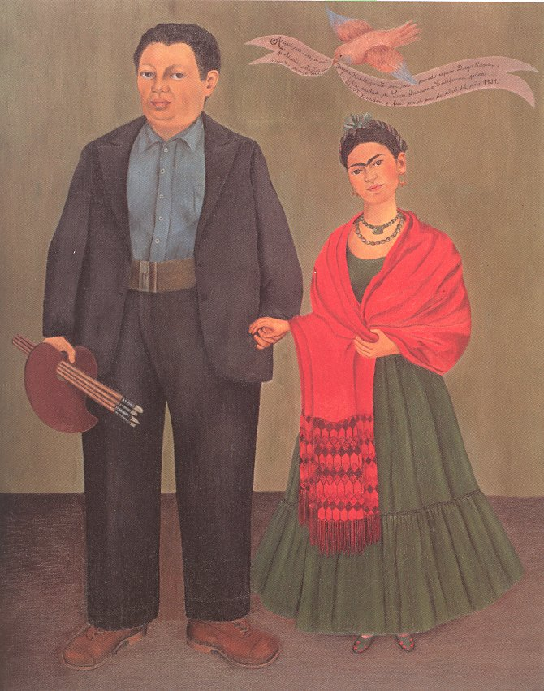
Frida Kahlo
asymmetrical

Slide 16
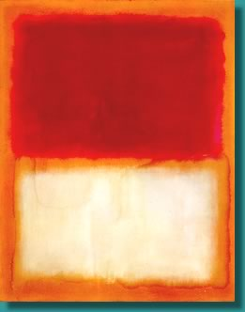
Mark Rothko
symmetrical

Slide 17
James Whistler

Slide 18
Rose Window at Notre Dame
radial

Slide 19
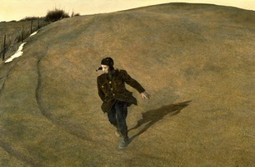
Andrew Wyeth
Emphasis
Emphasis is when the artist manipulates the Elements of Art so that your eye is drawn to a particular area.

Slide 20
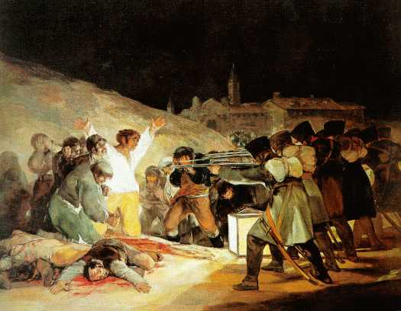
Francesco Goya

Slide 21
Commemorative Bronze, Kingdom of Benin

Slide 22
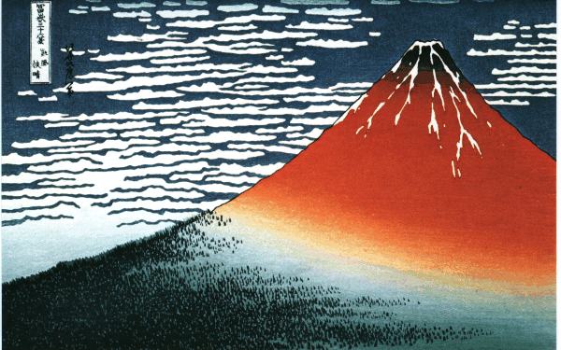
Hokusai

Slide 23
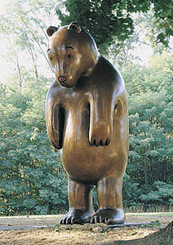
Tom Otterness
Proportion
Proportion refers to one piece of an object in relation to the rest of the object.

Slide 24
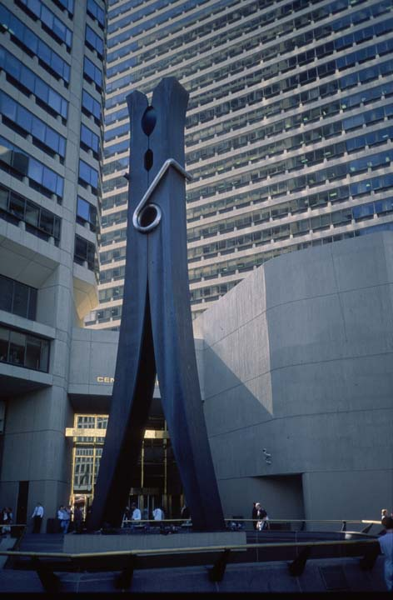
Claes Oldenburg

Slide 25
Fernando Botero

Slide 26
Amedeo Modigliani

Slide 27
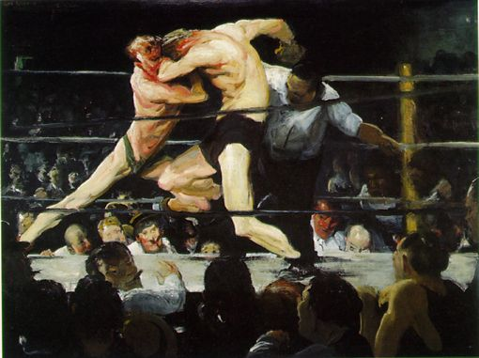
George Bellows
Movement
Directional Movement is a visual flow through the composition. It can be the suggestion of motion in a design as you move from object to object by way of placement and position.

Slide 28
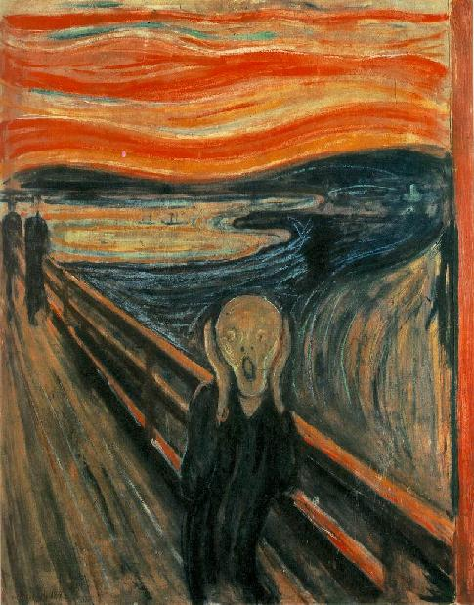
Edvard Munch The Scream

Slide 29
Antoni Gaudí

Slide 30
Vincent Van Gogh

Slide 31
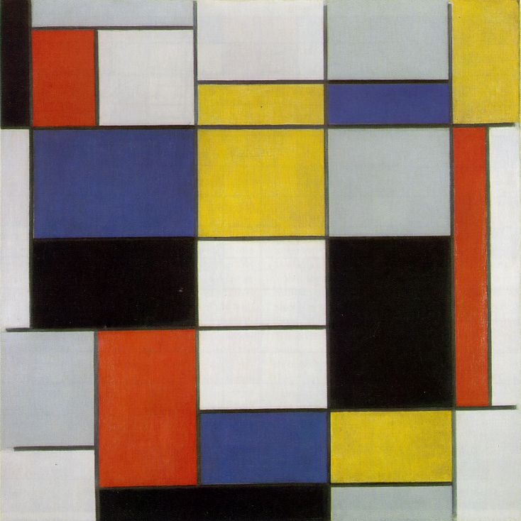
Piet Mondrian
Rhythm
Rhythm is movement in which some elements recur regularly. Like a dance it will have a flow of objects that will seem to be like the beat of music. Repetition.

Slide 32
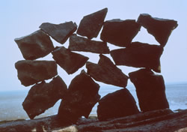
Andy Goldsworthy

Slide 33
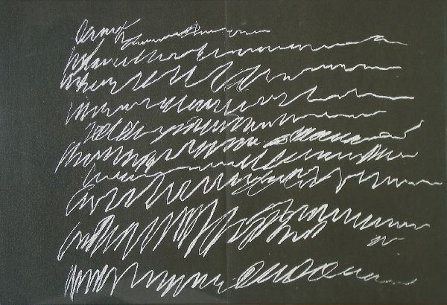
Cy Twombly

Slide 34
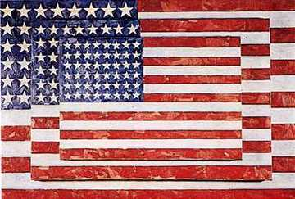
Jasper Johns

Slide 35
You Decide…

Slide 36
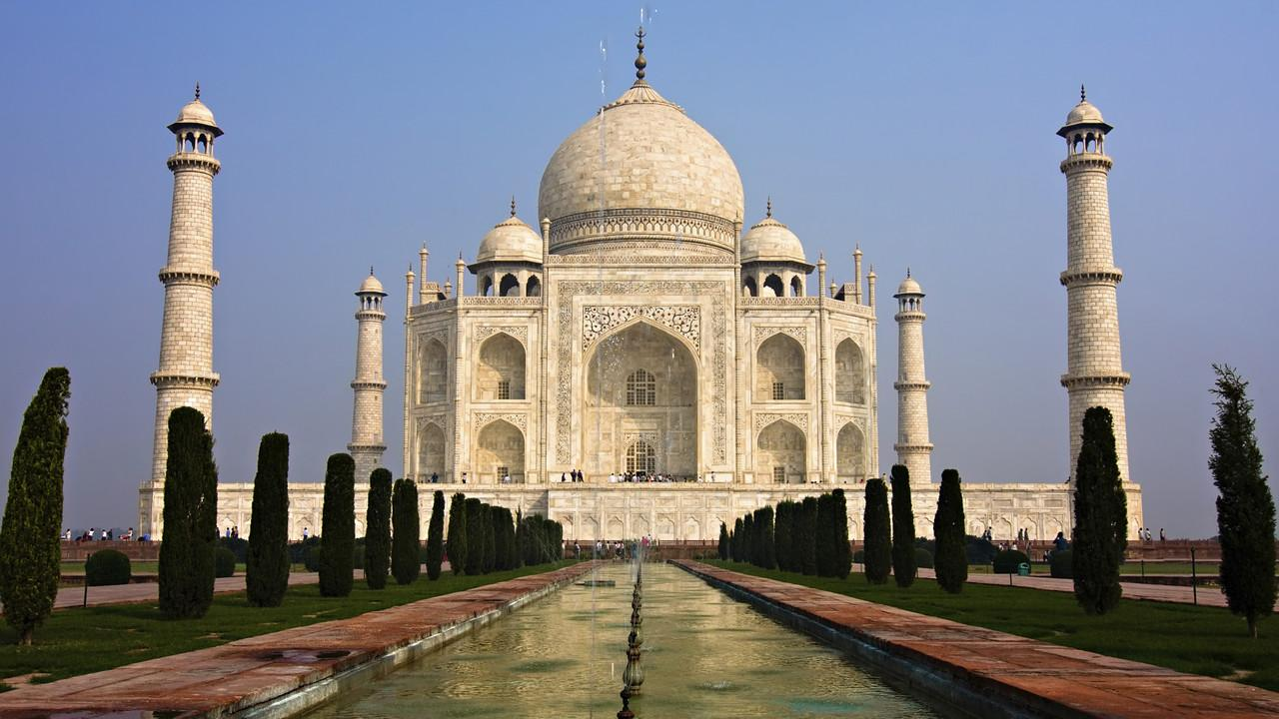

Slide 37
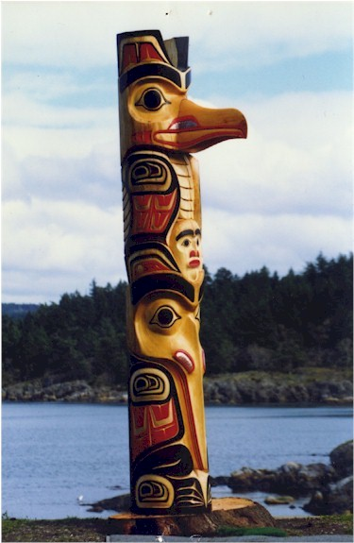

Slide 38
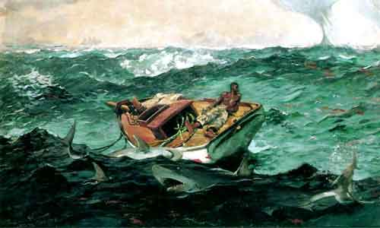

Slide 39
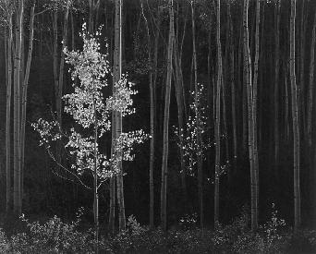

Slide 40
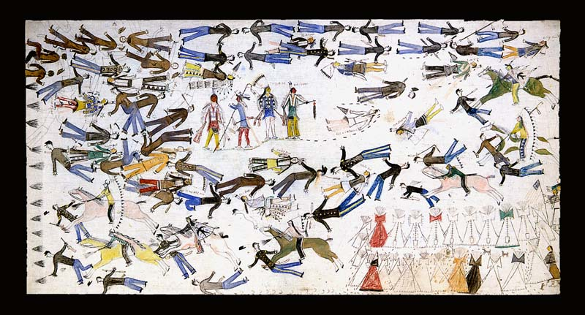

Slide 41
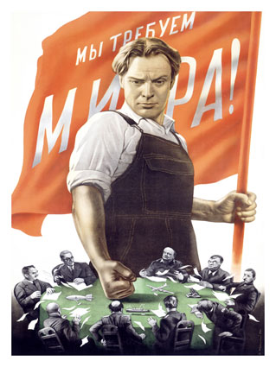

Slide 42
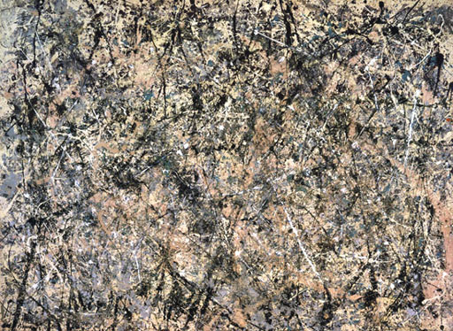

Slide 43
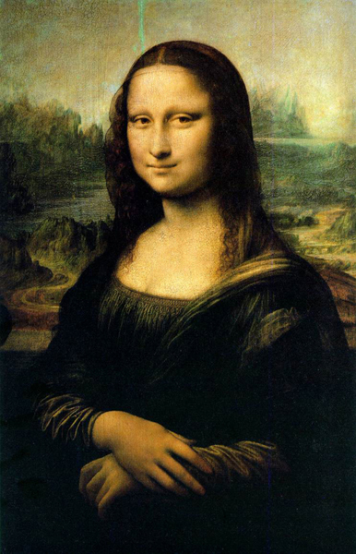

Slide 44
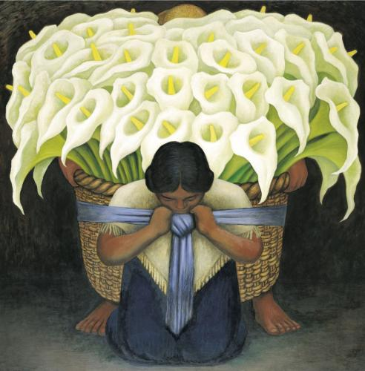

Slide 45
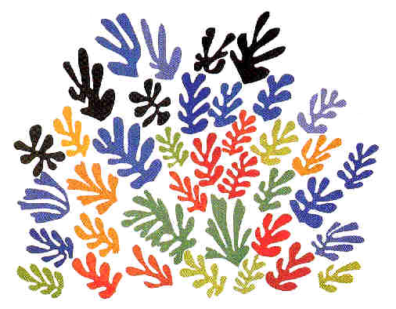

Slide 46
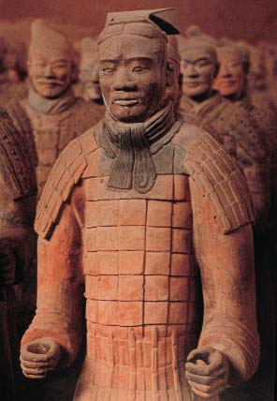

Slide 47
