Slide 1
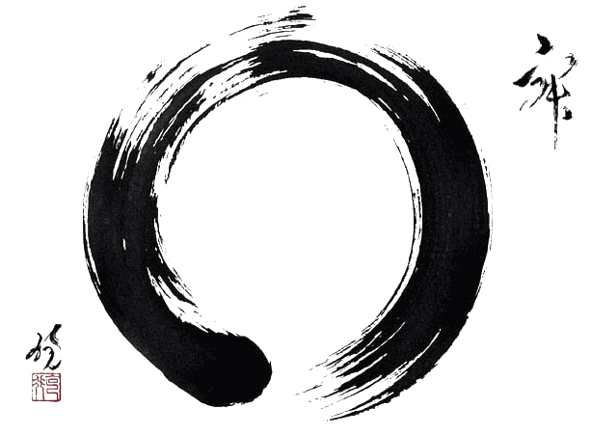
ZEN

Slide 2
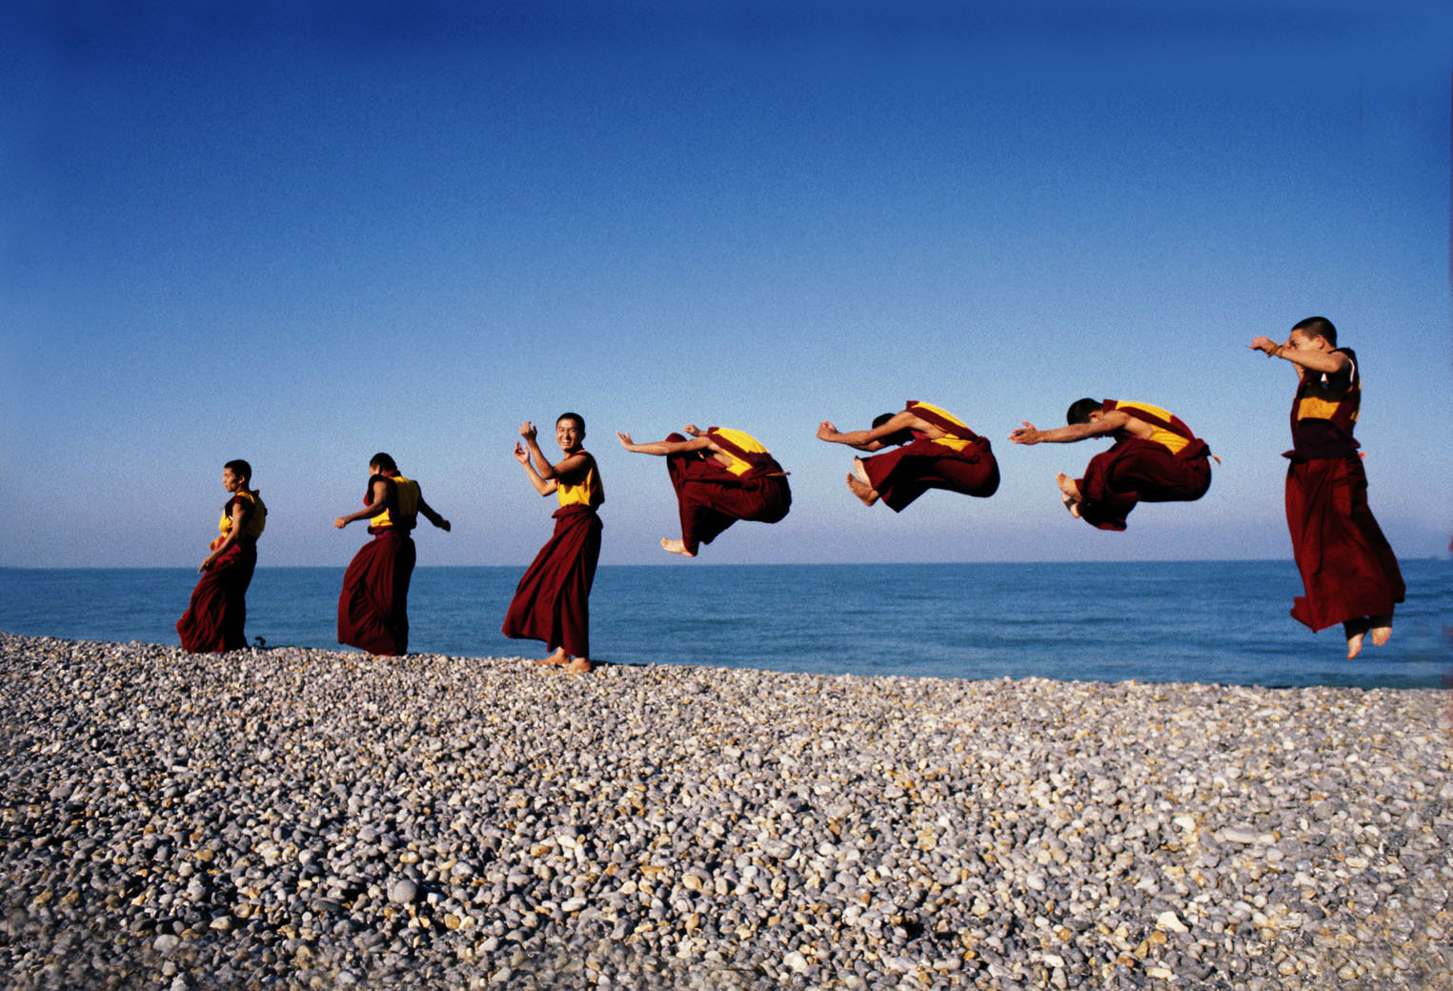
Mindfulness
“Mindfulness”
Living in the present moment

Slide 3
Wabi-sabi
A Japanese aesthetic which is sometimes described as one of beauty that is imperfect, impermanent, and incomplete.
Characteristics of the wabi-sabi aesthetic include asymmetry, irregularity, simplicity, modesty, intimacy and appreciation of nature.

Slide 4
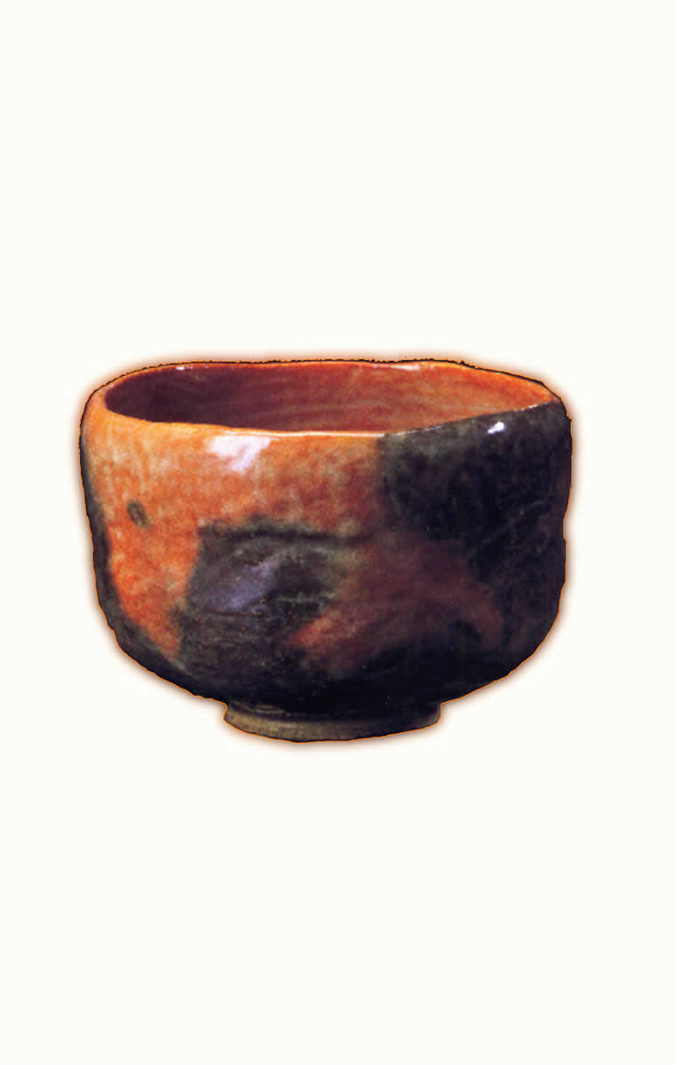
Tea Bowl

Slide 5
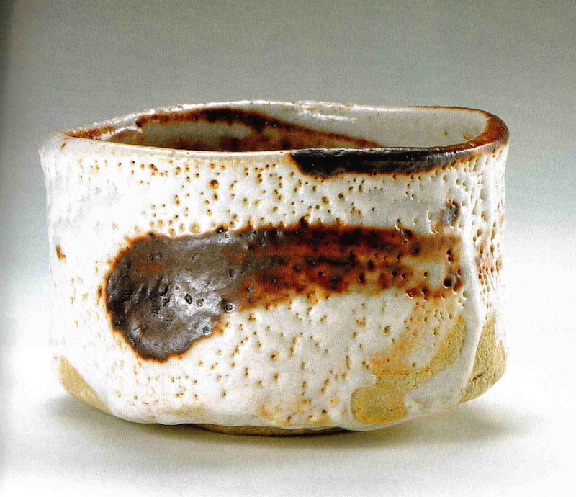

Slide 6
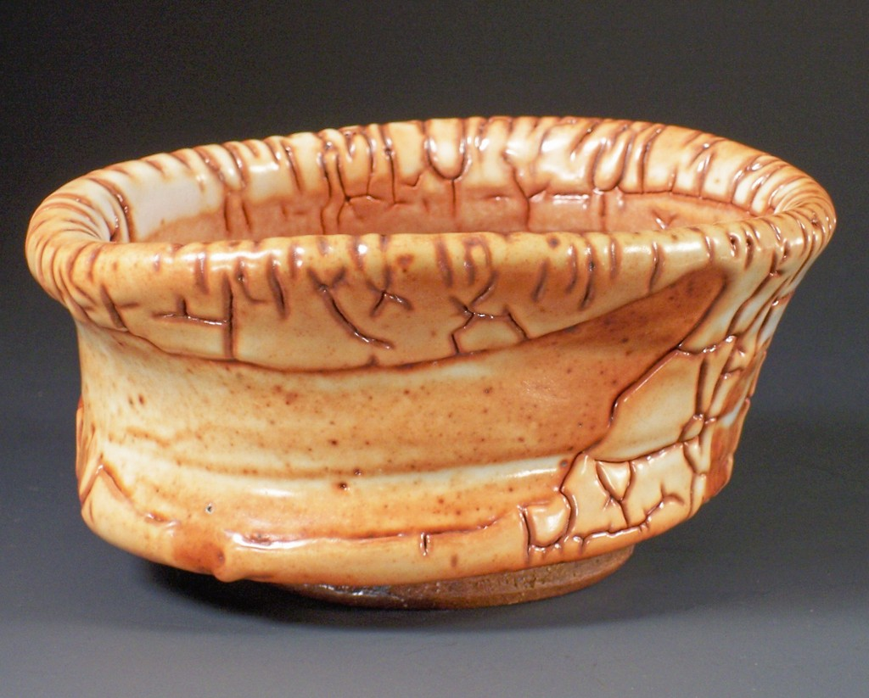

Slide 7
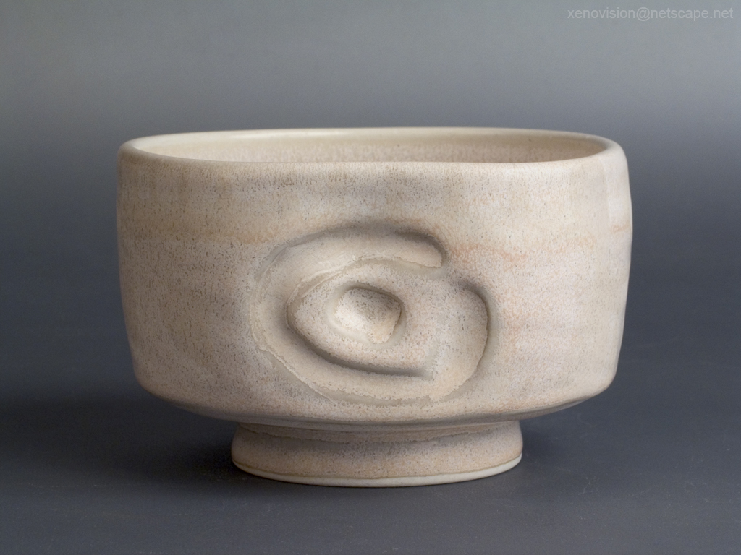

Slide 8
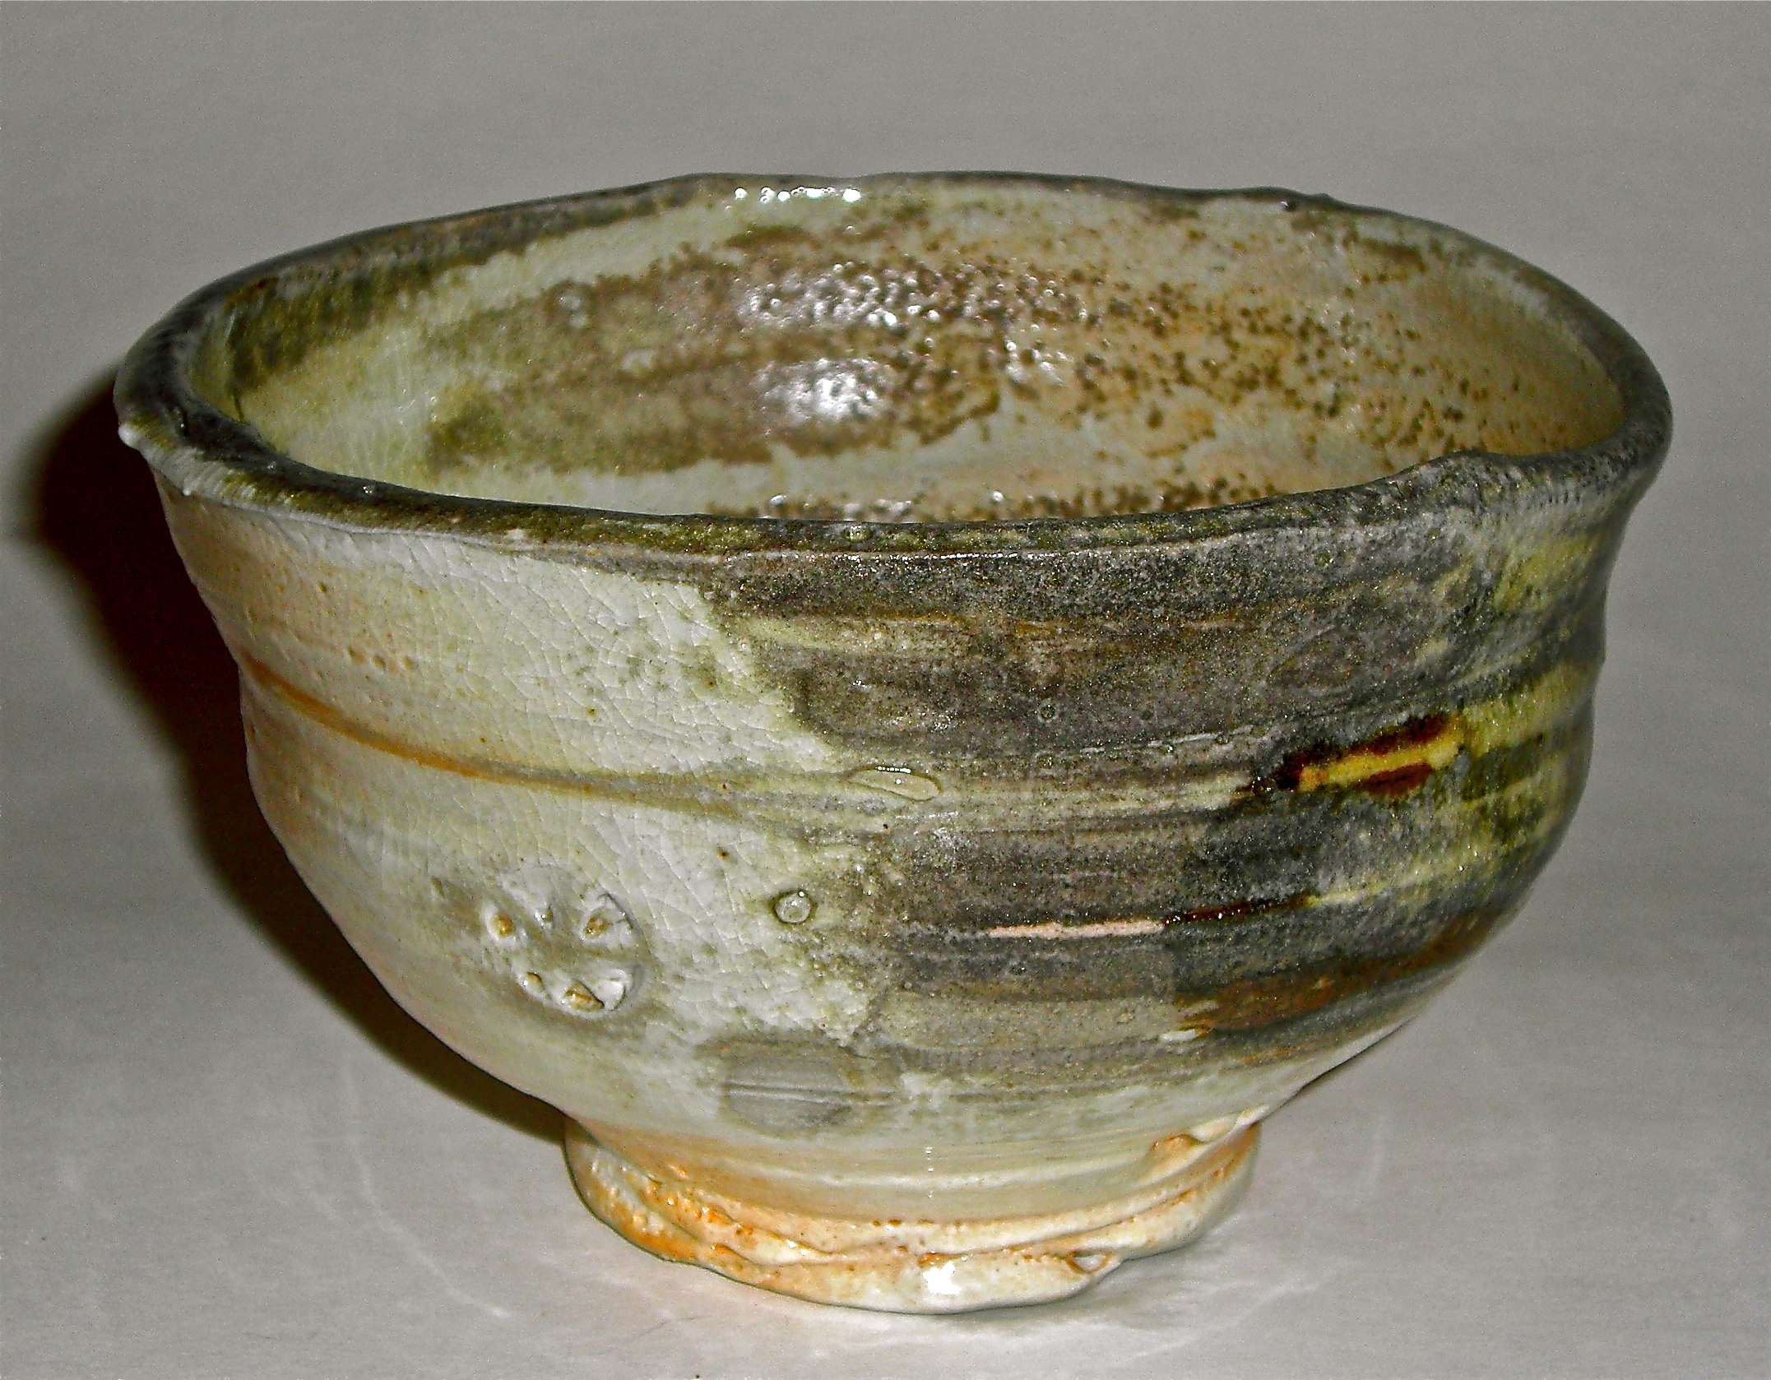

Slide 9
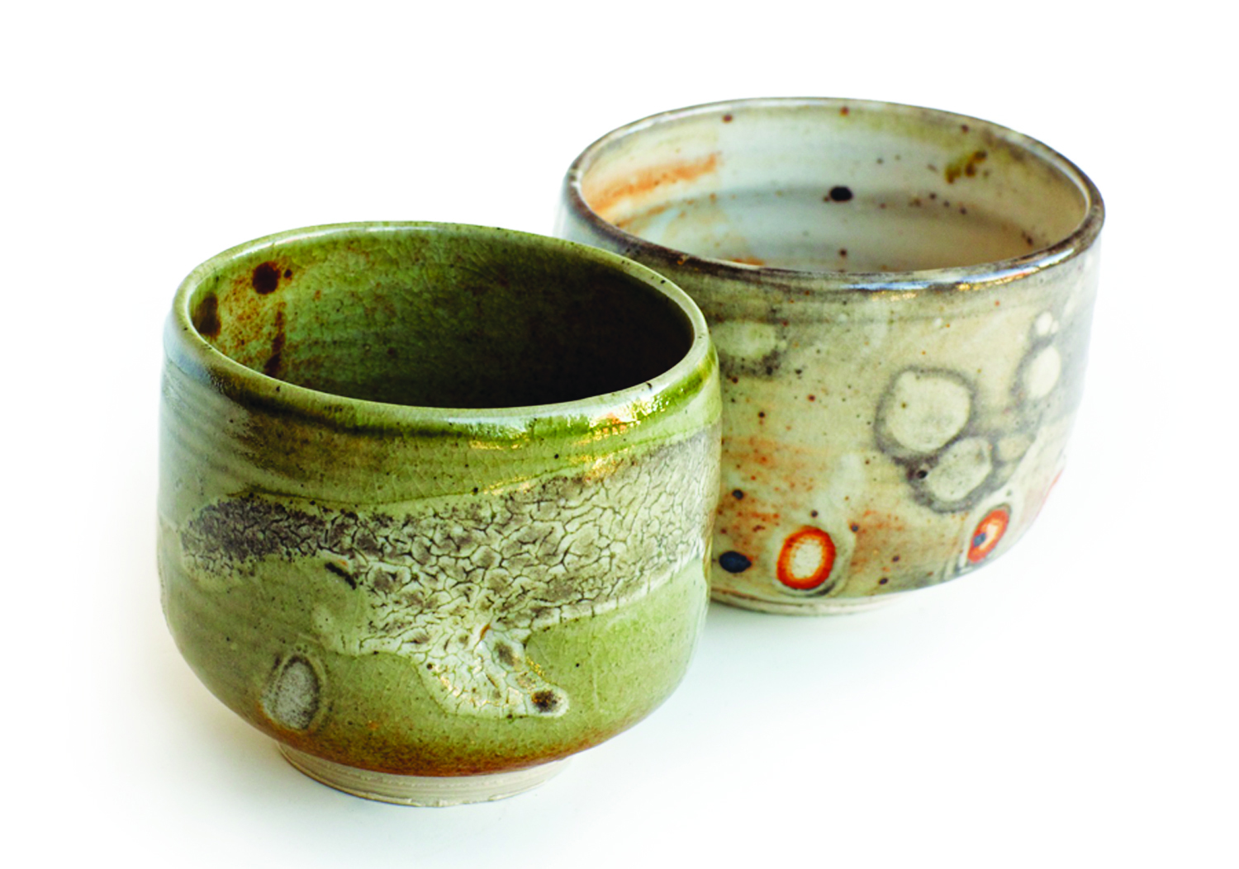

Slide 10
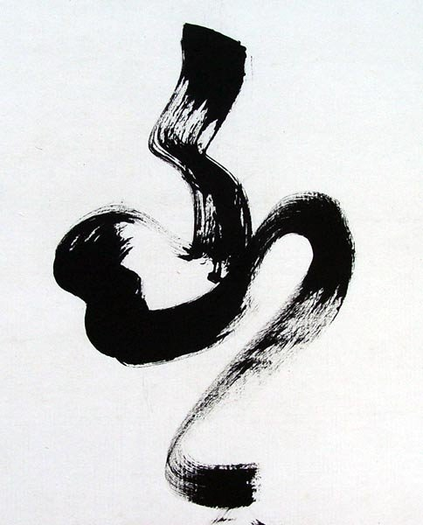
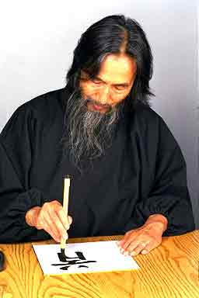
Calligraphy

Slide 11
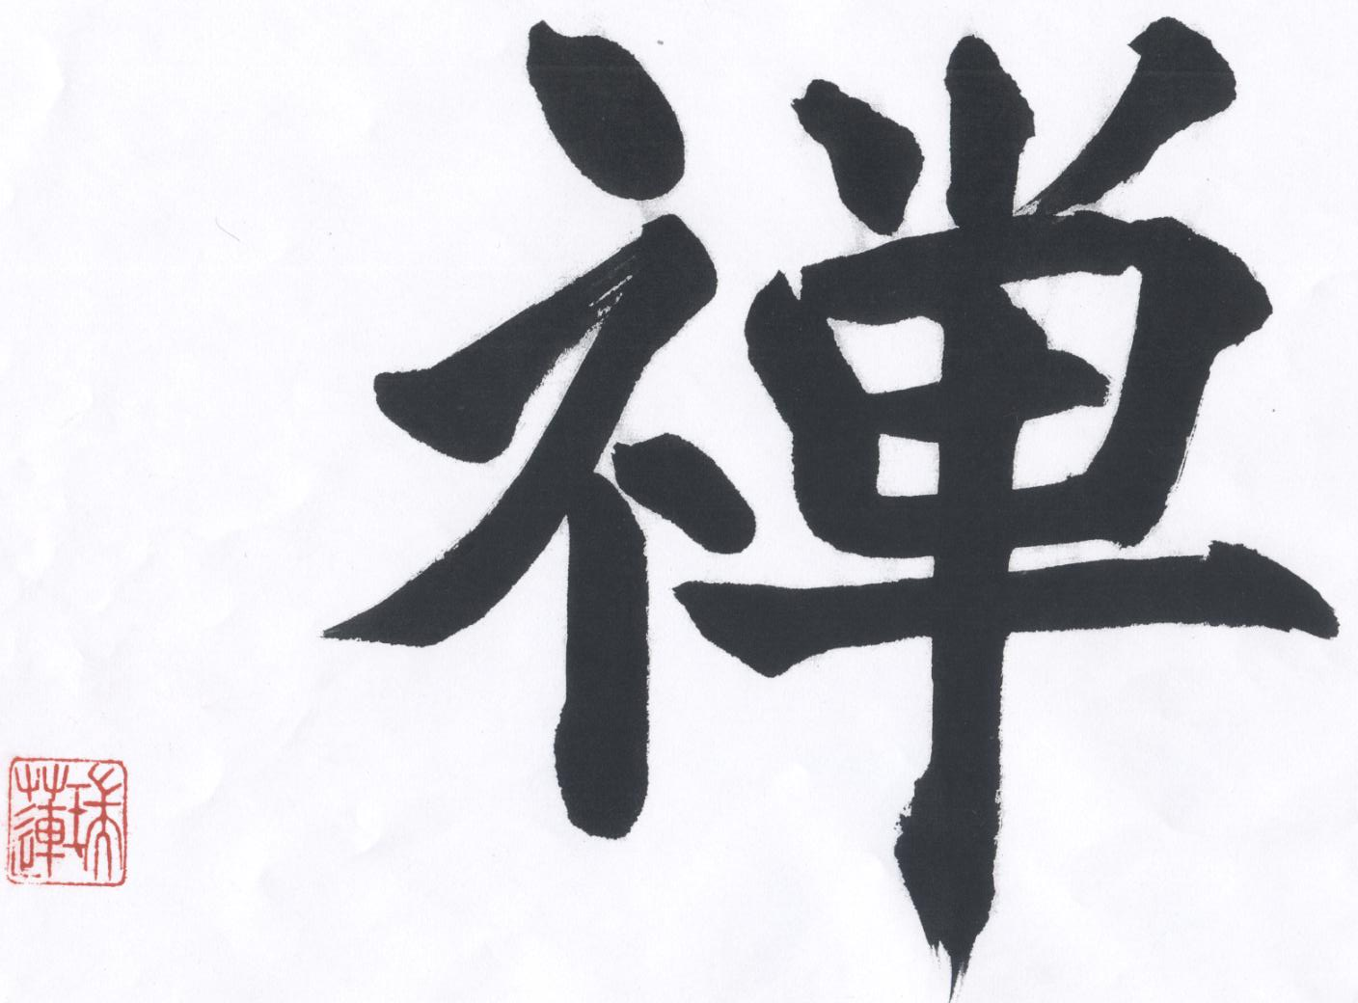
Zen kanji

Slide 12
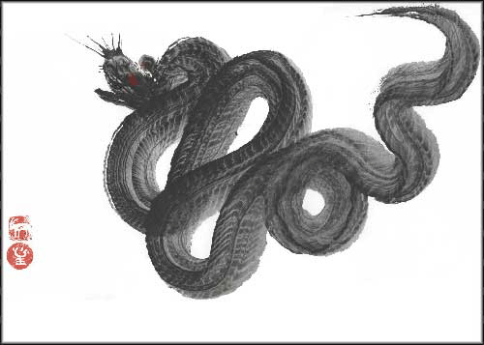

Slide 13
zen

Slide 14
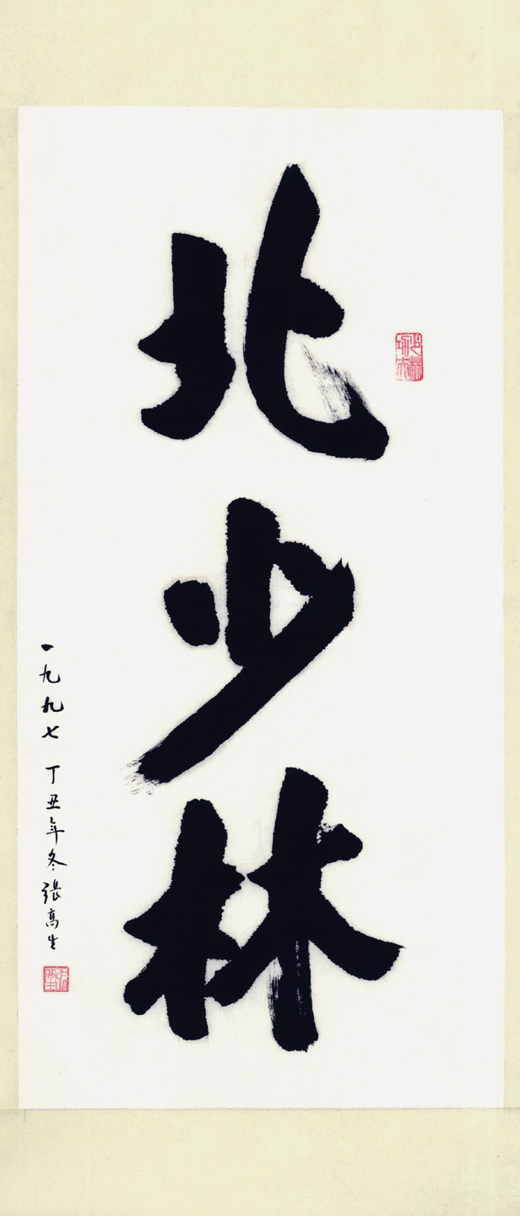
scroll

Slide 15
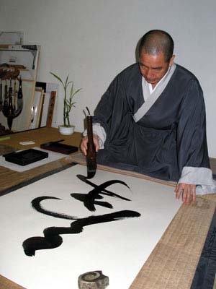
Doing calligraphy

Slide 16
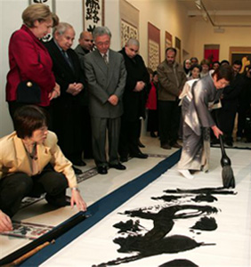
lady

Slide 17
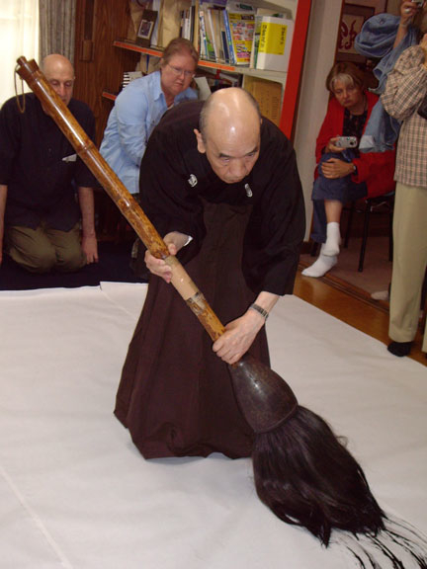
Old man

Slide 18
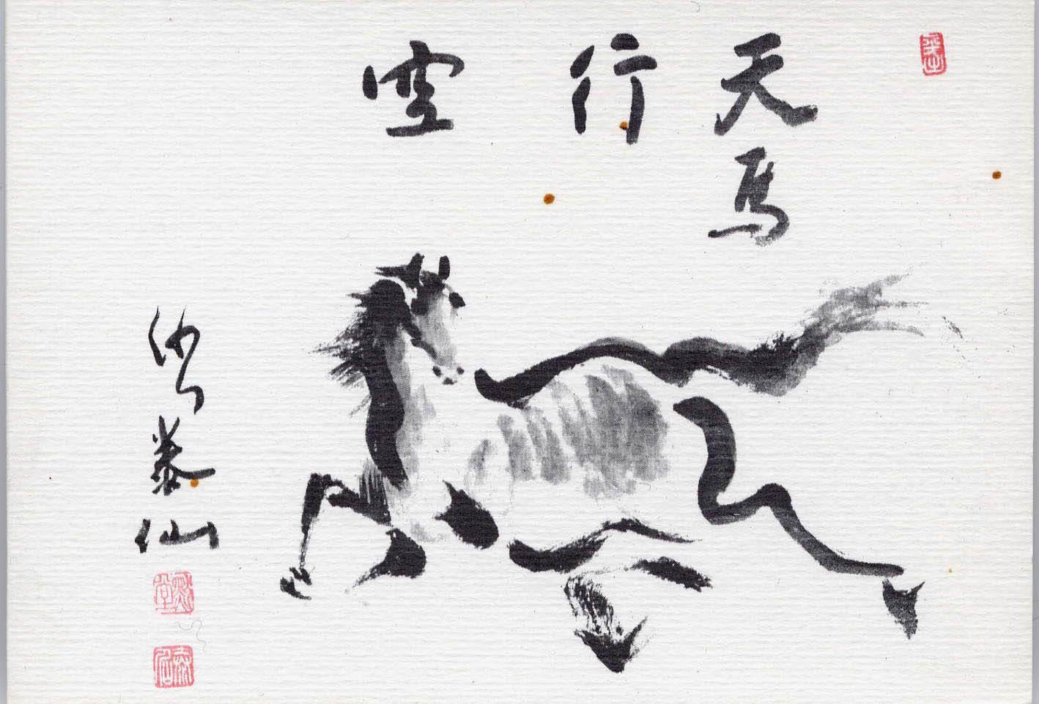
Sumi-e Painting

Slide 19
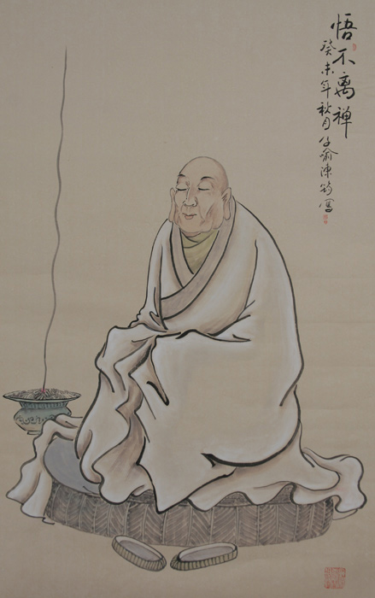
priest

Slide 20
dragonstaff

Slide 21
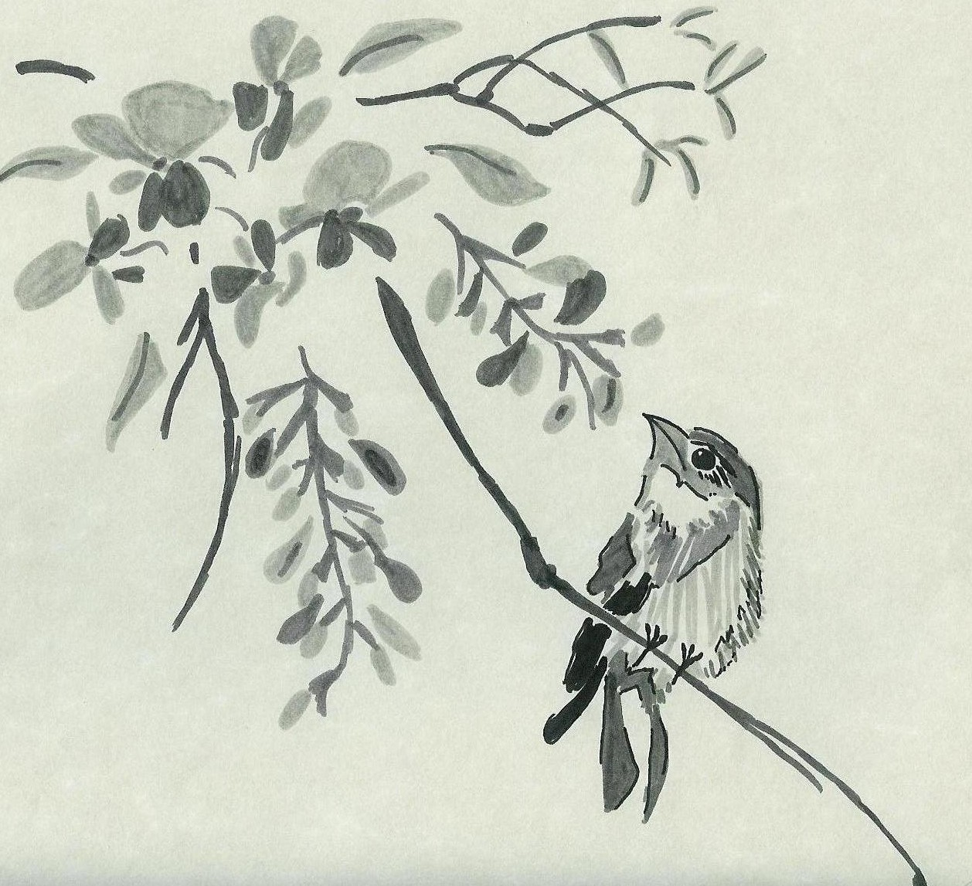
bird

Slide 22
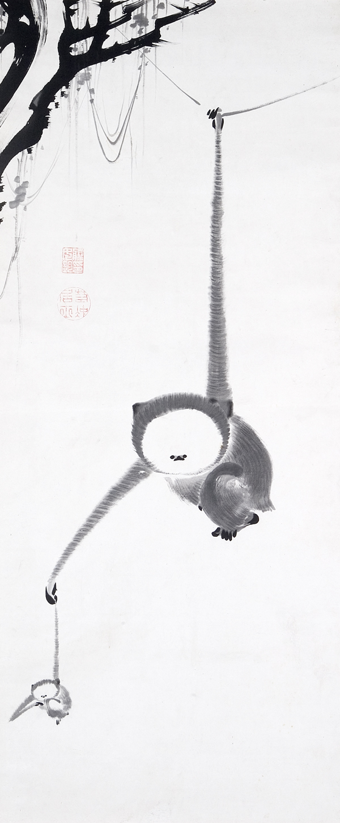
monkey

Slide 23
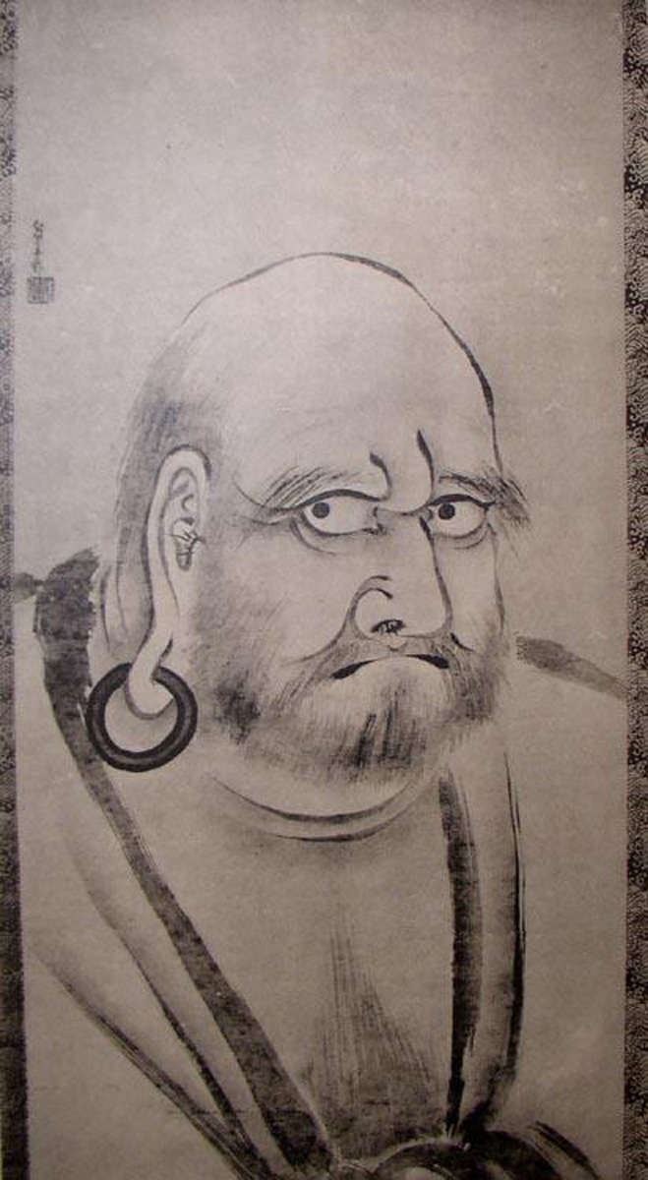
bodhidharma
Bodhidharma
is the Founder of Zen Buddhism.
He spent 9 years meditating in a cave!

Slide 24
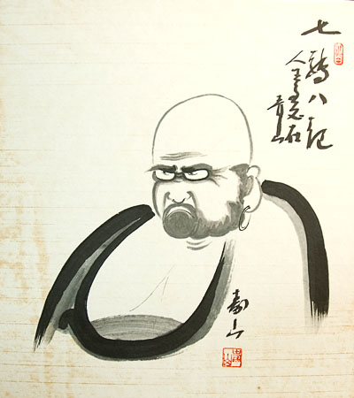
Bodhi-d

Slide 25
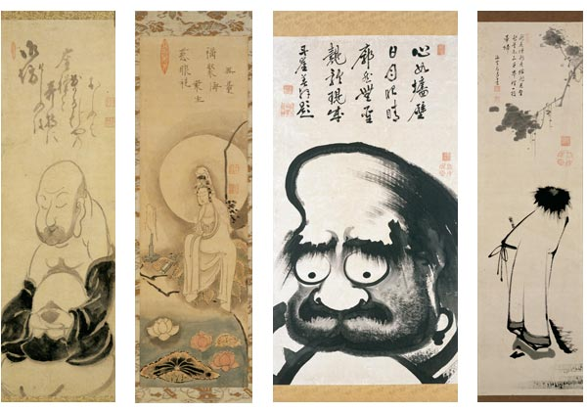
banners

Slide 26
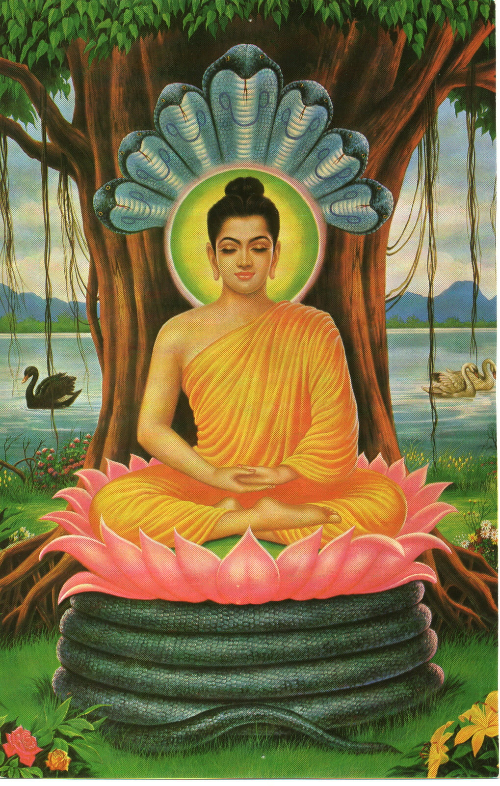
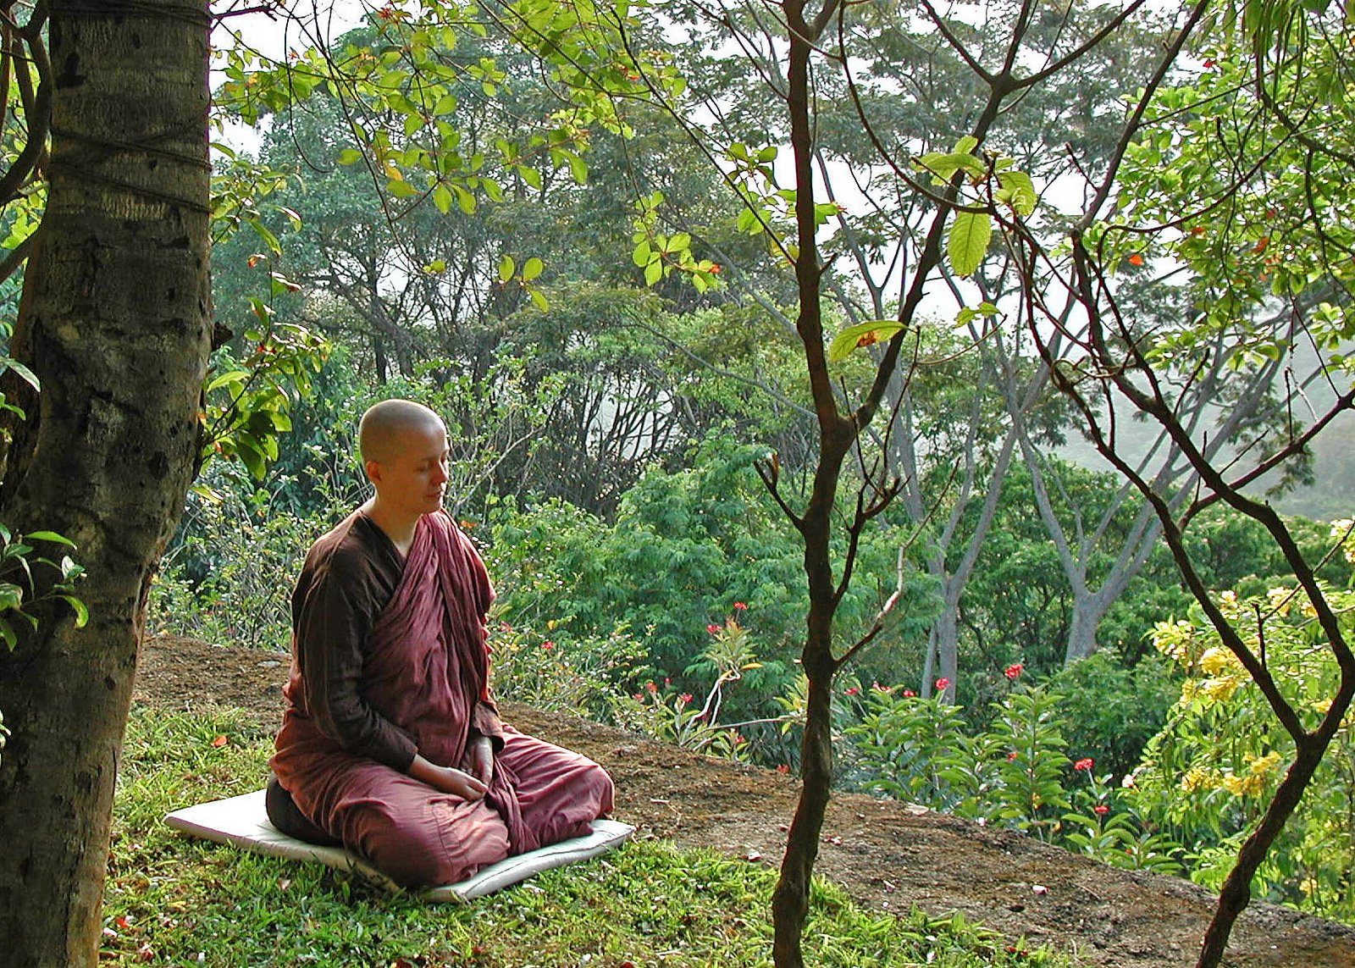
Meditation

Slide 27
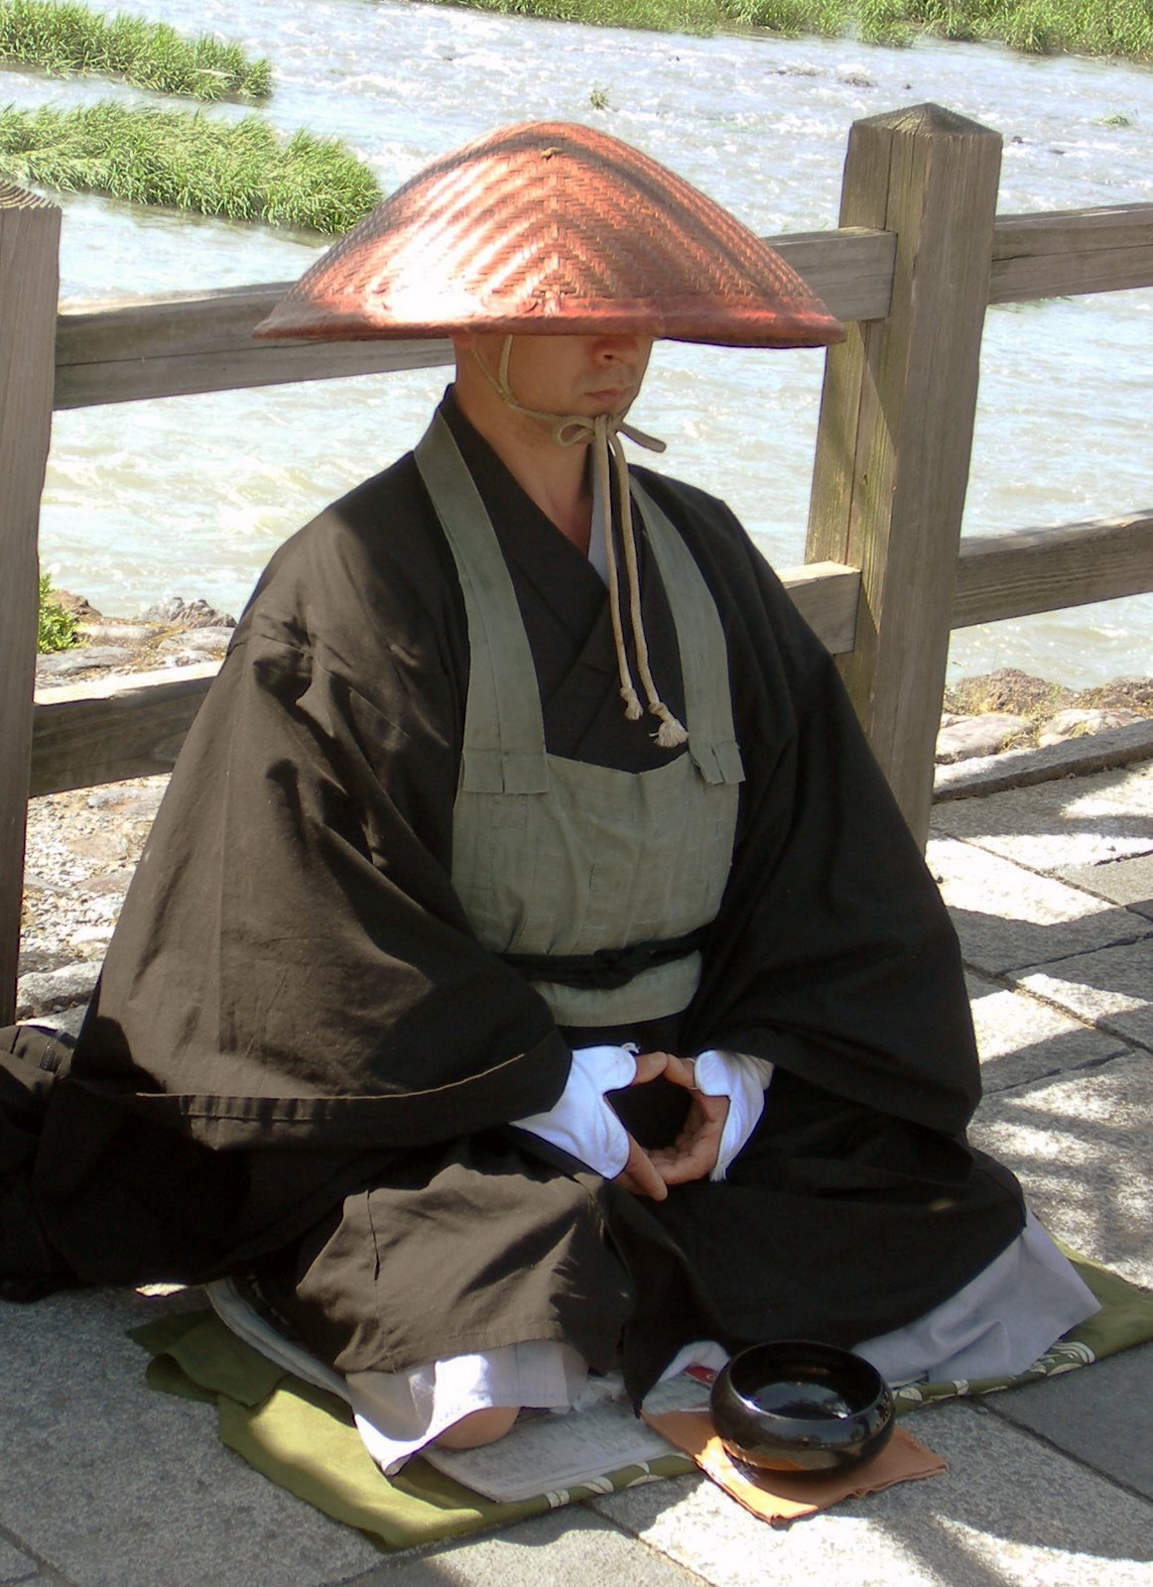
Zazen sitting in meditation

Slide 28
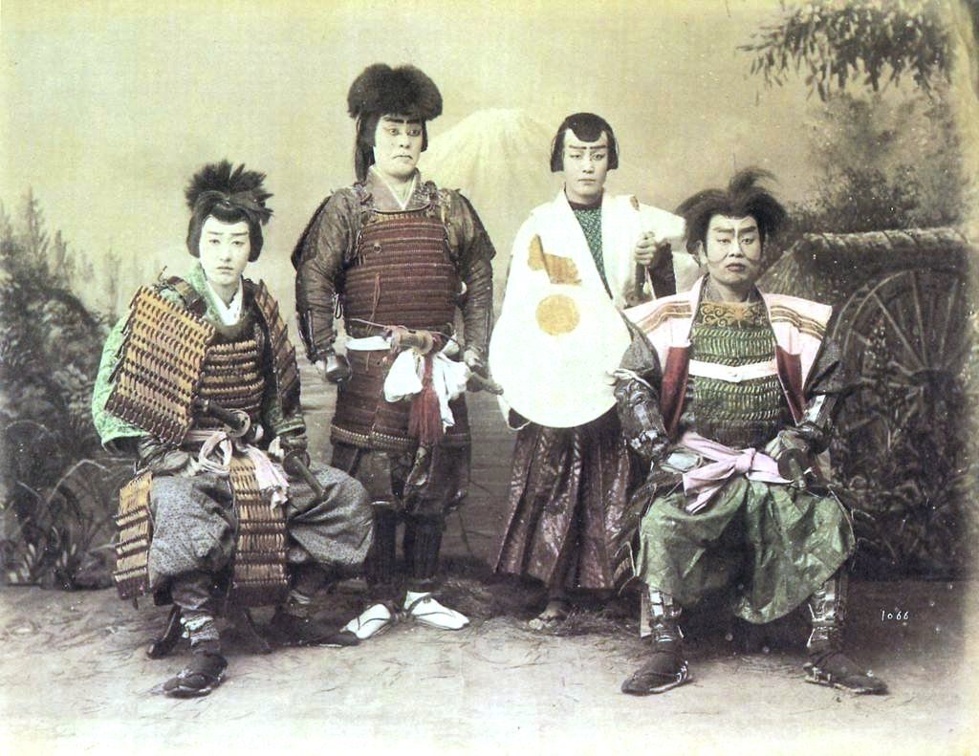
Samurai

Slide 29
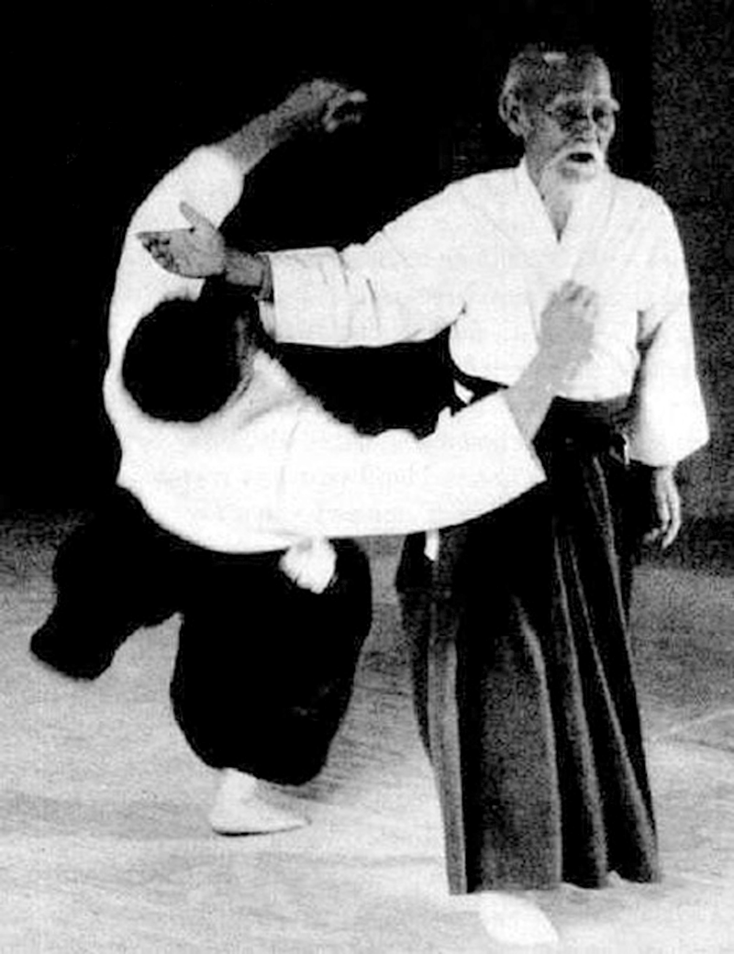
Aikido the peaceful martial art

Slide 30
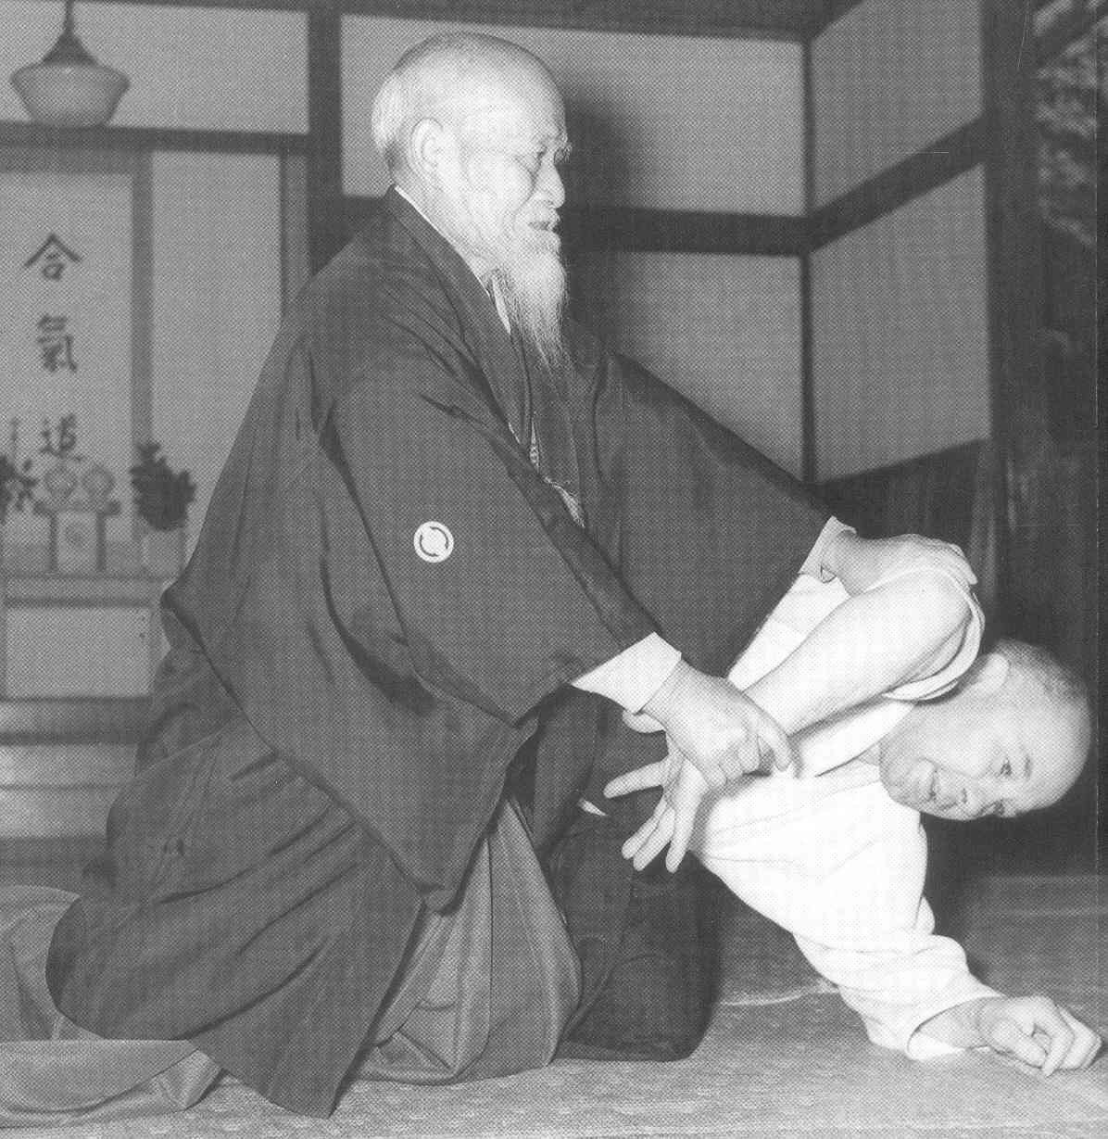
aikido2

Slide 31
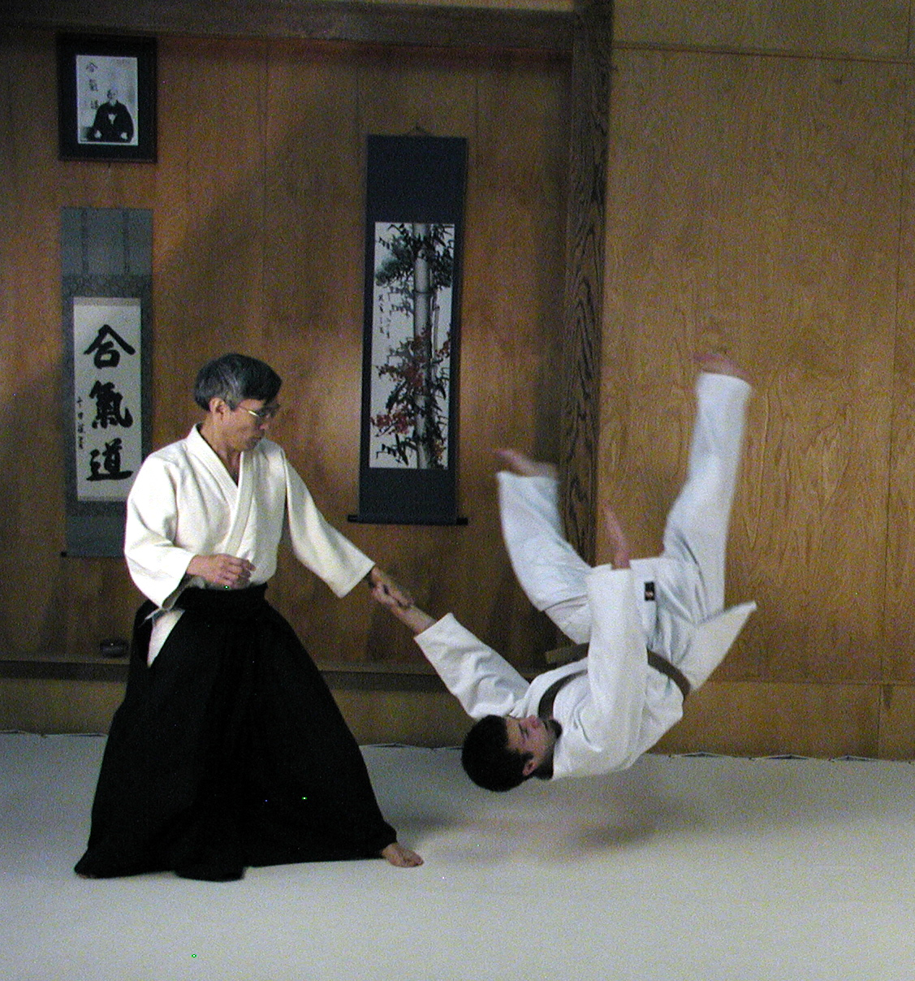
aikido3

Slide 32
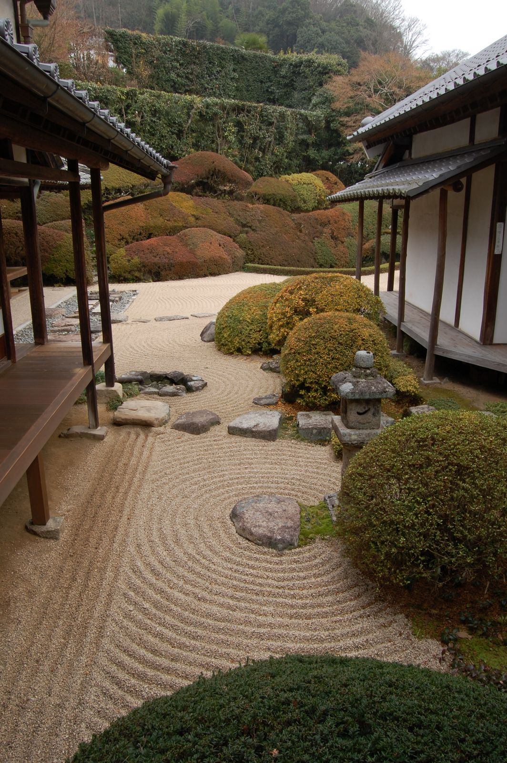
Zen Garden

Slide 33
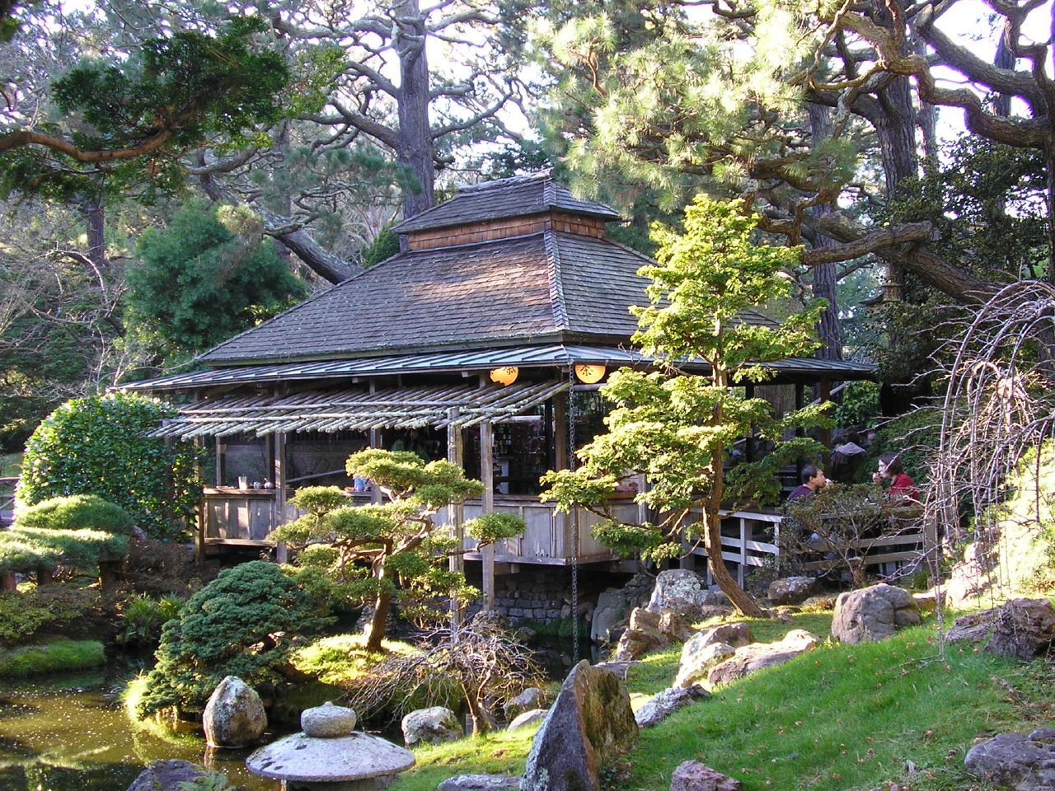
Teahouse

Slide 34
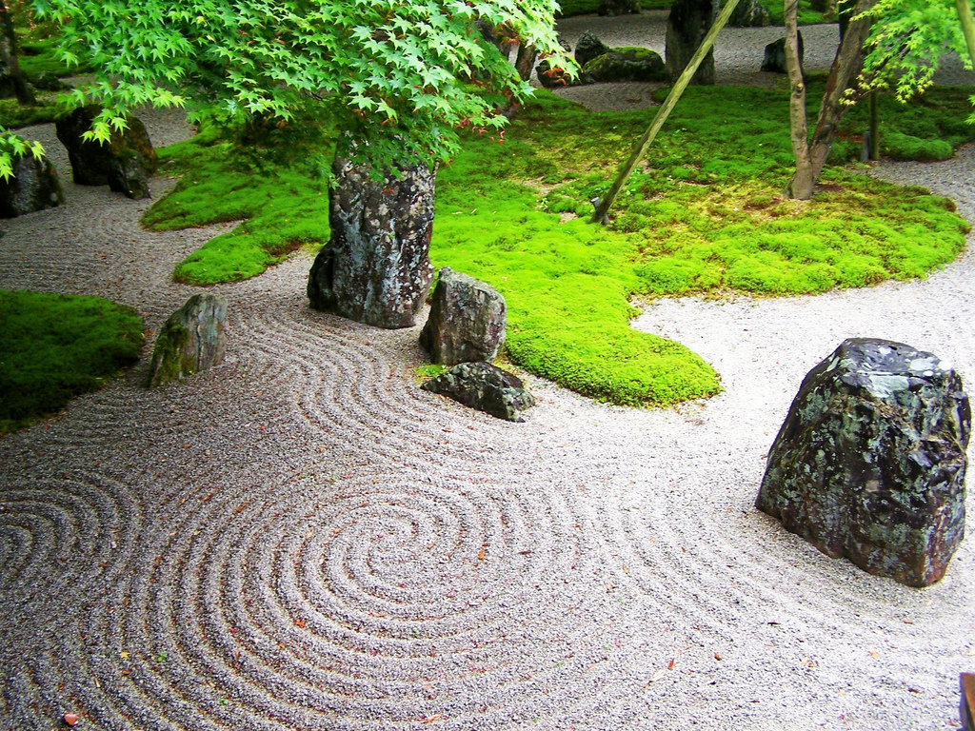
garden2

Slide 35
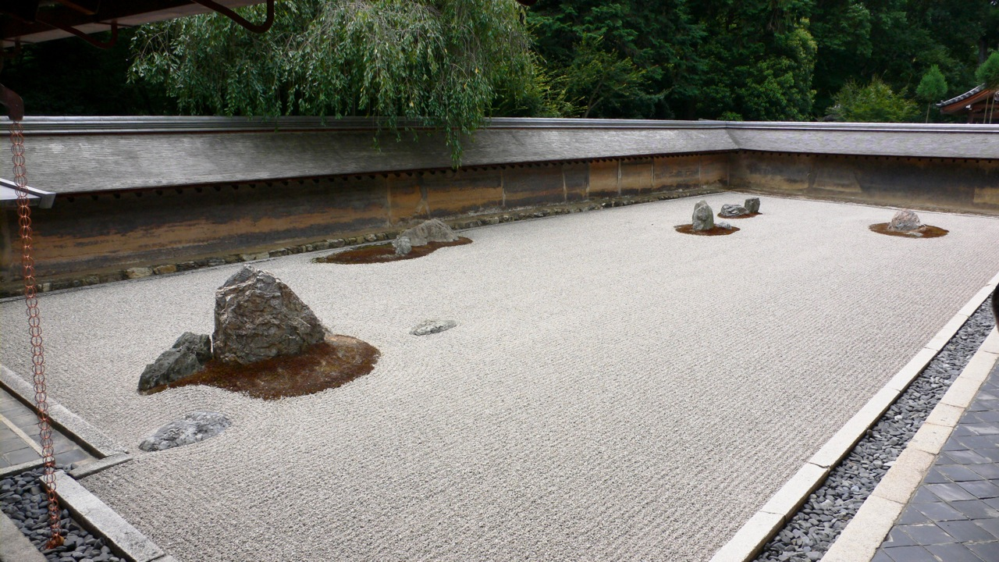
garden3

Slide 36
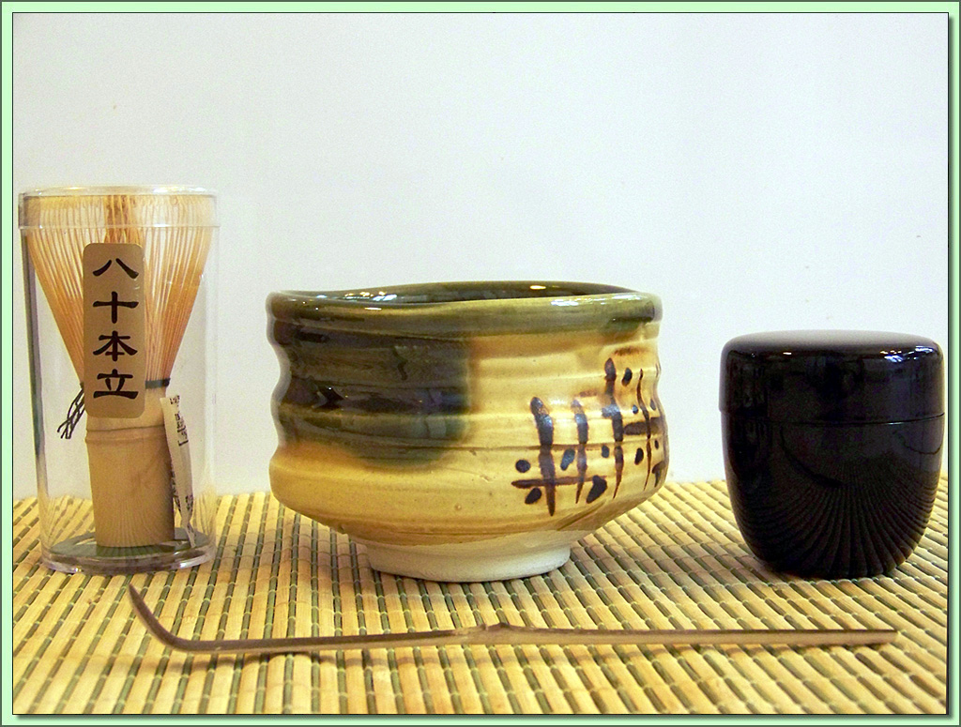
Tea ceremony

Slide 37
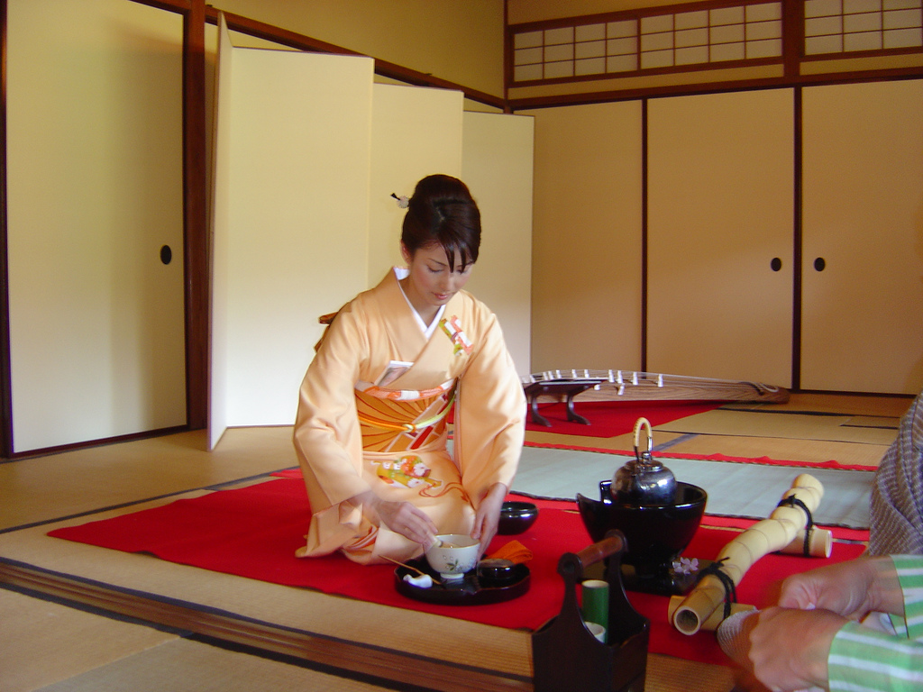
Performing tea ceremony

Slide 38
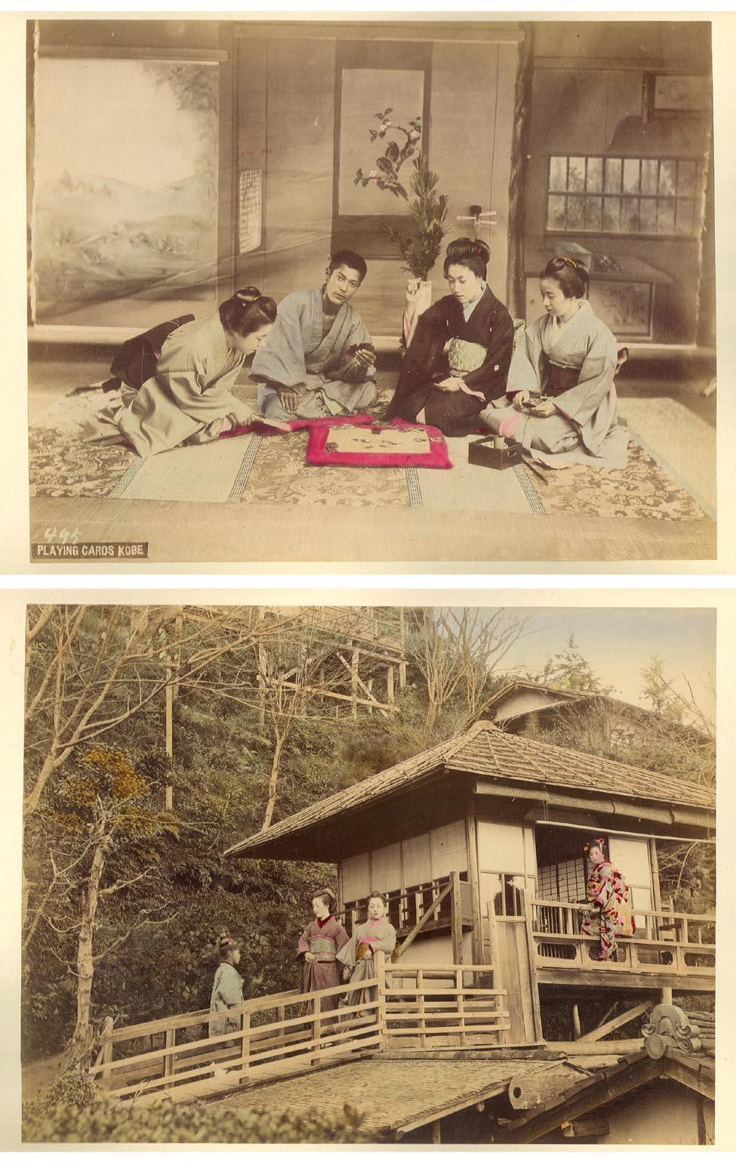
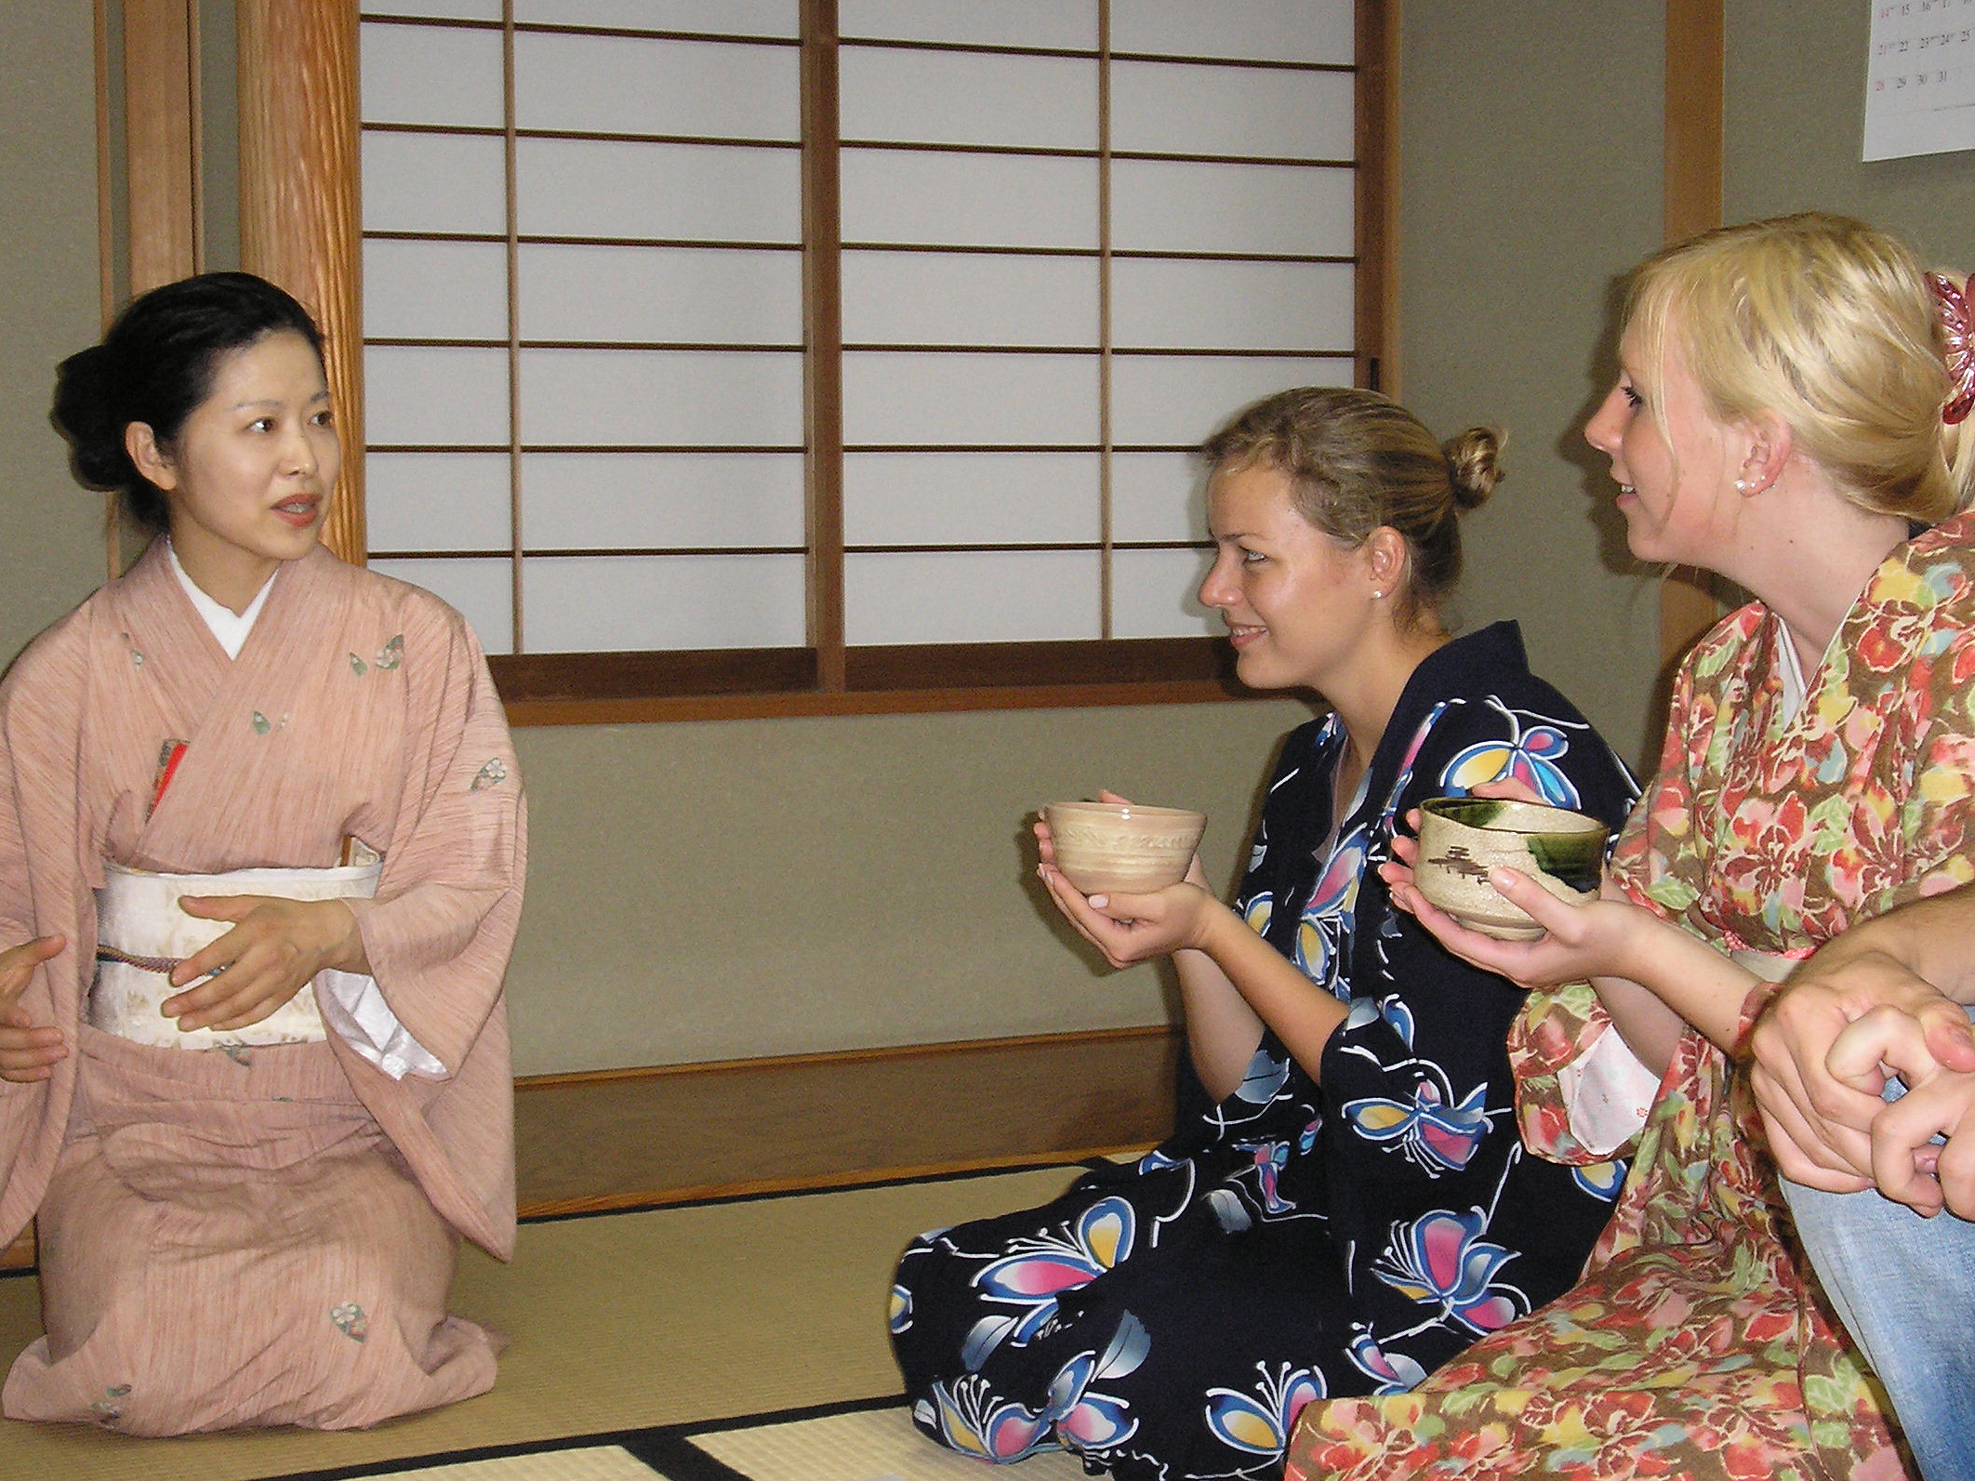
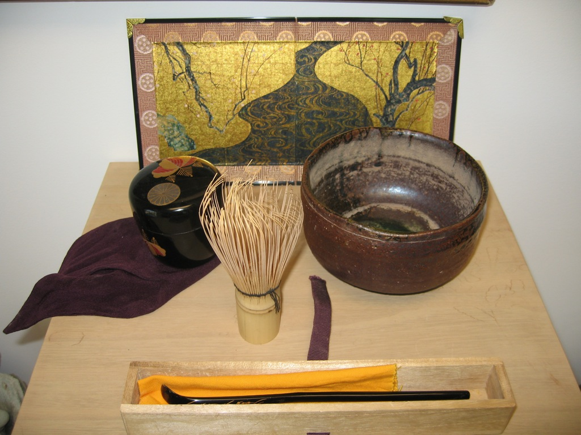
Tea house vintage

Slide 39
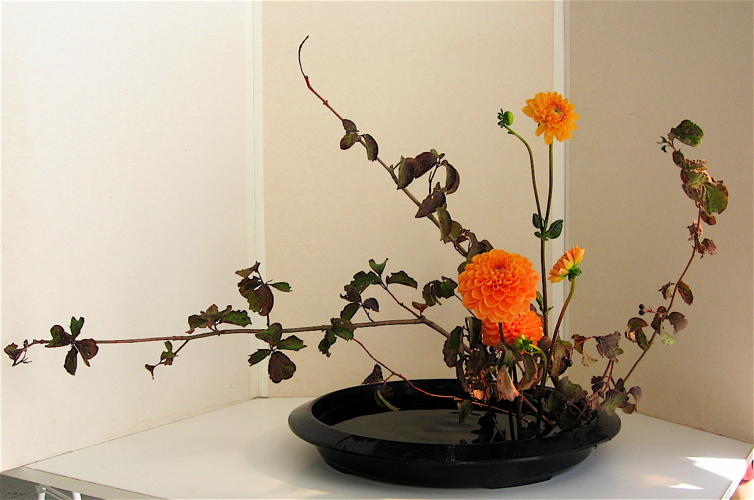
Ikebana (flower arranging)

Slide 40
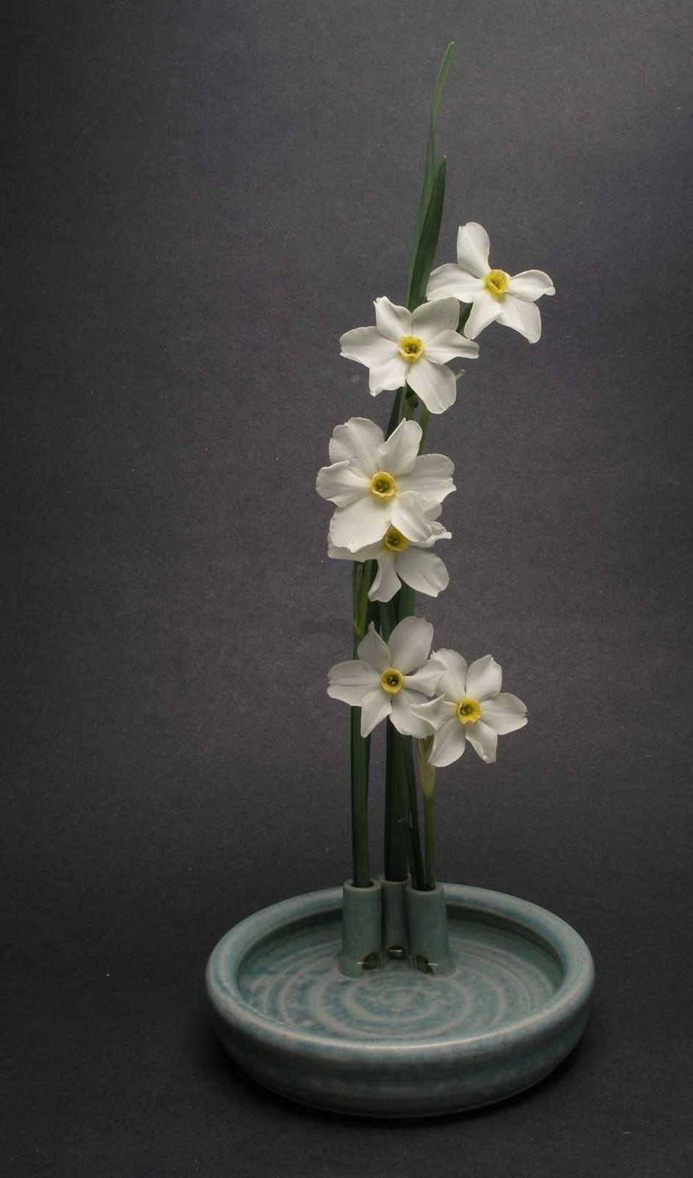
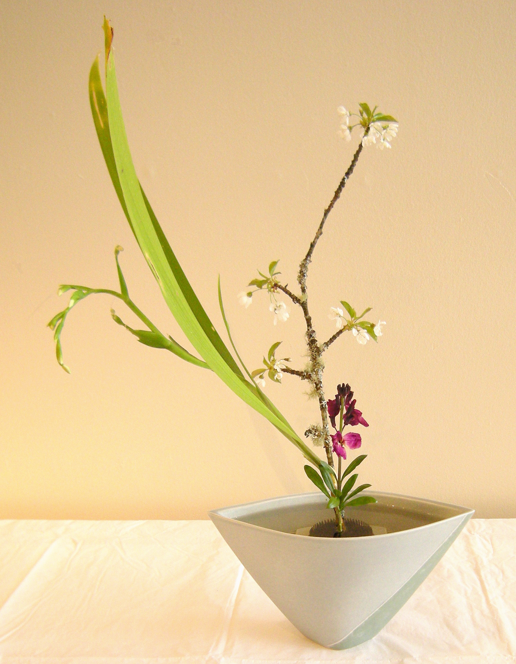

Slide 41
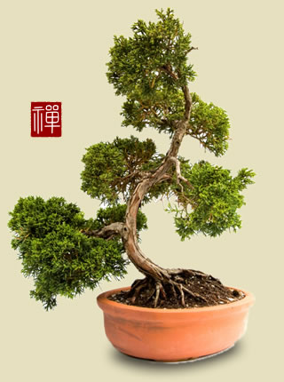
Bonsai Tree

Slide 42
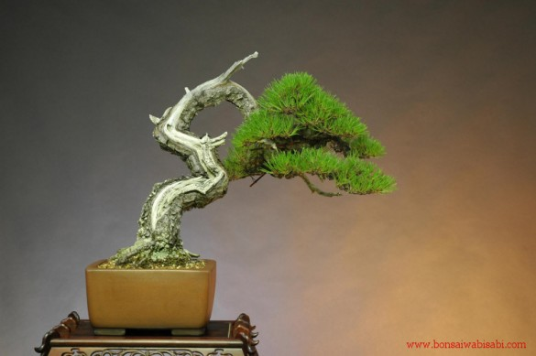

Slide 43
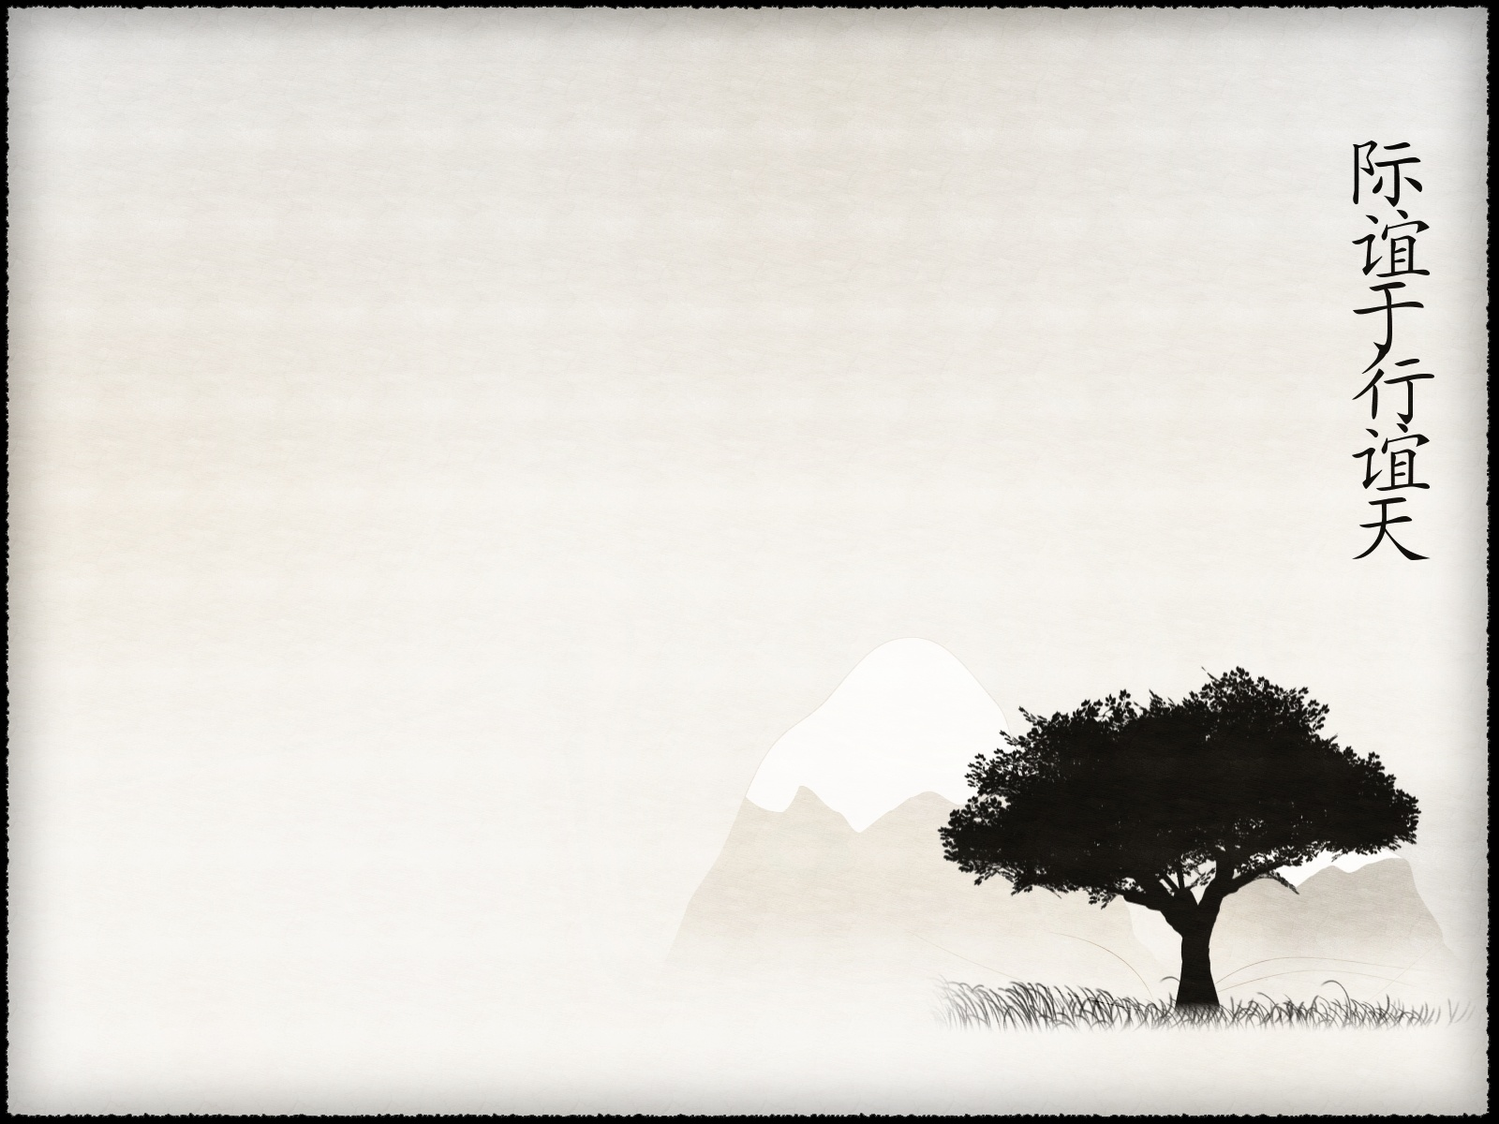
ZEN
Mindfulness
Wabi-sabi
Simplicity
Harmony with nature
Imperfection
Impermanence

Slide 44
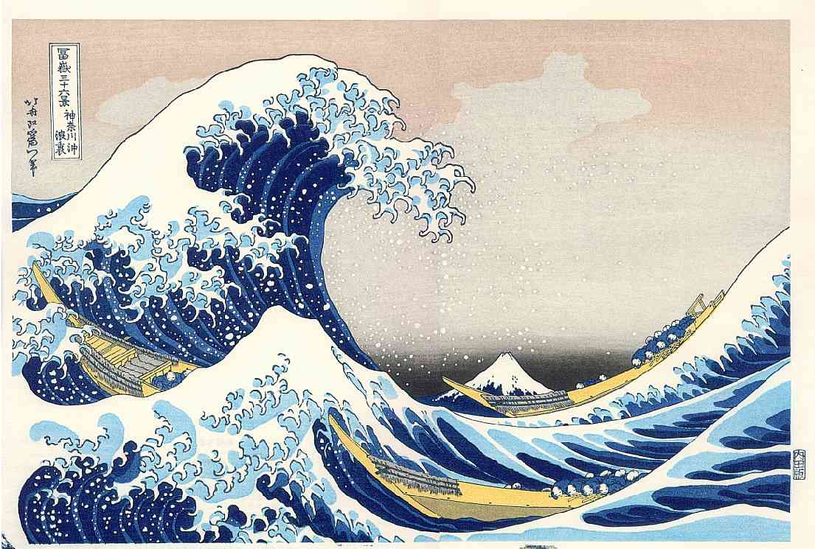
Great wave

